Slide 1
“Project with a Purpose”
Engineering
Notebook
Name: Type here
Course: Type here

Slide 2
01
Objective:
I will be able to define philanthropy and consider the 3 T’s as I generate ideas for my engineering “project with a purpose”.

Slide 3
What is philanthropy?
The practice of giving treasure, time, and/or talents to help make life better for other people (3T’s)
3T’s:
Time
Talent
Treasure
Love of humankind
“Philos” from Greek meaning love
“Anthropos” from Greek meaning humankind

Slide 4
Project with a Purpose
Students get to create a project of their own Time and Talent.
The school provides the “Treasure” of computer design tools, 3D printing resources, and a laser cutter.

Slide 5
02
Objective:
I will be able to describe and follow the steps in the engineering design process as I work on my “project with a purpose”.

Slide 6
Scientific Method Engineering Design Method
A series of steps that scientists follow to learn more about the natural world
Involves making observations and doing experiments
A series of steps that engineers follow to solve problems
Involves designing a product or system that meets criteria or accomplishes a specific task

Slide 7
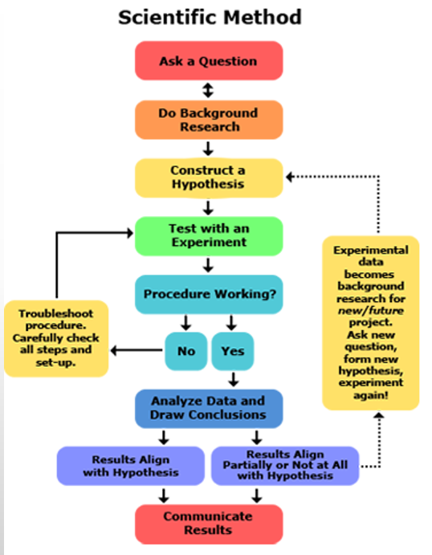
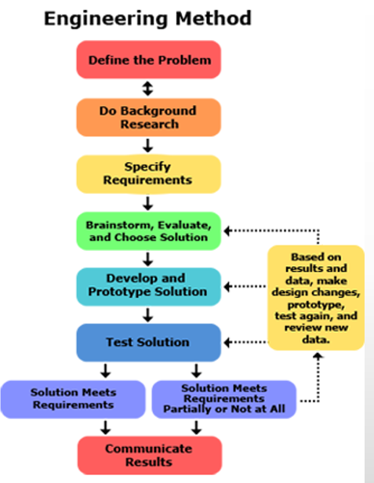

Slide 8
Step 1: ASK
Brainstorm two ideas for designs that you can do to help others, using our available resources.
Conduct one interview with a teacher, staff member, family member, or other adult and come up with one additional idea for a project.
Describe your ideas on the next page. Be ready to share your ideas with your classmates.
Define the Problem
The Engineering Design Process always begins with a problem or need. You will design and 3D print or laser cut an object designed with philanthropy in mind.

Slide 9
Who did you interview to get your third idea?
Idea 1: Type here.
I interviewed…
Idea 3: Type here.
Idea 2: Type here.

Slide 10
Select your best idea for further research and refinement. Describe why you chose this idea.
Who are your project beneficiaries (the individual or group of people who will benefit from your project)?
I selected
Type here.
What need will your project satisfy, or which problem will your project solve?
How does your project tie in to the idea of philanthropy?
Type here.
Type here.

Slide 11
Who will be your client for this project? The client is an adult who will help you refine your project ideas, review your designs, and provide feedback. The client can be the intended end user, but the client does not have to be the end user. (For instance, if this is a surprise gift for someone, the client would need to be someone else.)
My client is…

Slide 12
Step 2:
If solutions do exist, speak to customers or users about how that product or system may need improvement.
Research
Begin by exploring what solutions may already exist for your problem.
Don’t reinvent the wheel! Avoid past mistakes through research.

Slide 13
How did you conduct your research? (Talk to customers or users, talk to your client, read about existing solutions, look online, examine or use current solutions, …)
What did you learn from your research? What existing solutions already exist? Are there ways that the existing solutions could be improved?
Type here.
Type here.

Slide 14
Step 3:
Engineers may have to stay within limits involving:
Materials available
Budget
Time
Size of the solution
Equipment and tools needed
Weight
Durability
Style
Etc.
Specify Requirements
What requirements must your design meet in order to be successful?
These requirements are known as criteria and constraints.

Slide 15
What criteria and constraints need to be considered for your design?
Which criteria and constraints concern you most or are most likely to cause problems for your design? What can you do to avoid these problems?
Type here.
Type here.

Slide 16
Step 4: IMAGINE
Brainstorm ideas. Describe them below. You can also add pictures or sketches of your ideas.
Generate Ideas
Type here. Add picture below.
How will you solve your problem? Think of as many different solutions to your problem as you can. The more ideas you have, the less likely you are to miss something great!
Ask your client, end users, classmates, or teacher to help you brainstorm.

Slide 17
More brainstormed ideas…
More brainstormed ideas…
Type here. Add picture below…
Type here. Add picture below…

Slide 18
Step 5: PLAN
Which solution did you choose? Why?
Choose a Solution
Type here.
After you have a list of solutions, evaluate them to see which one best fits your criteria, or guidelines that define success of your solution.

Slide 19
Step 6: CREATE
Add pictures of your initial CAD design here:
Develop the Solution
After the solution has been chosen, it must be developed.
For your project, this will involve modeling the solution in CAD software. You may also want to create quick physical prototypes to visualize aspects of your design.

Slide 20
More CAD pictures (additional views)

Slide 21
CHECKPOINT:
What feedback did your client give you?
Client Feedback
Type here.
Before you make your physical solution on the 3D printer or laser cutter, be sure to ask your client to look at your design and provide feedback. Use the client feedback form provided by your teacher.

Slide 22
Did you make any changes to the design based on the client feedback? If so, please explain:
Type here.

Slide 23
Step 7: MAKE
Add a picture of your first prototype here:
Build a Prototype
A prototype is an operating version of a solution. Your first prototype may be created by hand or it may be 3D printed or laser cut.
Prototypes are used for testing the features of your design.

Slide 24
Step 8: TEST
Typical testing for 3D prints include answering questions such as: Is it the right size? Is it strong enough? Do interlocking parts fit together correctly? Do moving parts operate smoothly?
You should evaluate your own design and also ask your client for feedback on the design.
Evaluate the Design
After the prototype is built, it is tested. Most likely, problems will be discovered and the design may need to be adjusted.
This could happen several times before the final product is completed.

Slide 25
What did you test? How well did your first prototype meet the requirements?
CHECKPOINT:
Client Feedback
Type here.
What feedback did your client give you about your design? How can you improve the design?
Type here.

Slide 26
Step 8: IMPROVE
After the prototype is built, it is tested. Most likely, problems will be discovered and the design may need to be adjusted.
This could happen several times before the final product is completed.
Make Needed Changes
The design process almost always requires several iterations, or repeated steps.

Slide 27
What do you plan to improve on your next design iteration (repeated step)?
Show a picture of your new and improved design idea.
Type here.

Slide 28
Use these pages to document your design iterations and improvements. Show pictures of each new design. Tell your story and explain what you are improving each time you make a change. Follow the engineering design process and describe your steps. You can make extra copies (Slide>Duplicate Slide) if you need more pages.

Slide 32
CHECKPOINT:
Deliver your final solution to the end user. Show how your design is solving a problem for the end user. Include a quote from the end user and a picture showing the solution in action.
Client Feedback and Solution Delivery
Show your final solution to the client and ask for final feedback. Use the client feedback form provided by your teacher.
Type here.

Slide 33
Step 9: SHARE
Add your presentation slide content to the blank slides which follow this page.
Communicate Results
Once the final design is completed, engineers communicate their results with their company and customers.
You will create a few slides (3-5) to share your final design with your classmates.

Slide 34
Presentation Checklist
Describe how the idea of philanthropy influenced or inspired your choice of a problem to solve.
Describe any problems that you needed to solve to create your gift and describe how you solved them.
Describe your recipients or clients and tell what they think about your design (what is best about your design and what could be improved).
Cite any sources used for information or images that you did not personally create.
Use a large font for readability.
Show your design (including actual photos and snips or drawings from your CAD software)
Describe the benefits of your gift for your recipient or client
Describes how you used the engineering design process to create your solution. Your presentation should show that you have a good understanding of the steps in the engineering design process

Slide 39
Thanks!
Engineering Design Process
https://www.sciencebuddies.org/science-fair-projects/engineering-design-process/engineering-design-process-steps
Please keep this slide for attribution.

