Slide 1
LESSON 9 - EXECUTING YOUR PLAN FOR POSITIVE IMPACT

Slide 2
THINGS TO THINK ABOUT…
Do you have the resources and materials you need ready to make your project happen?
Do you have a date and location for your project/event?
Do you have tasks assigned to class members or other supports for the day of the event so it flows smoothly?
Do you have individuals and at least one organization that are willing and able to support you?
Have you made follow-up contact with social media followers or local TV and radio stations for publicity?

Slide 3
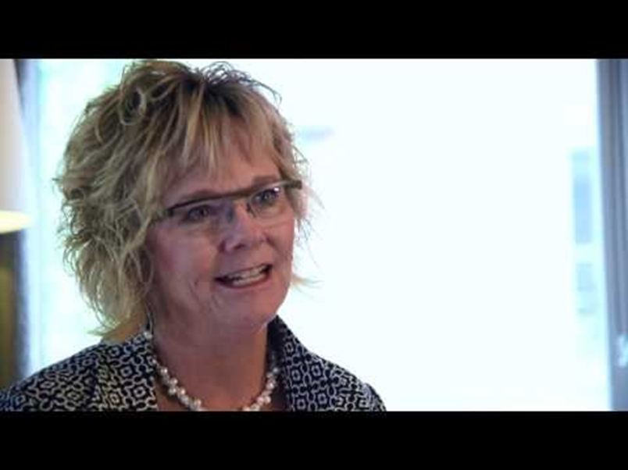
VISUALIZE THE IMPACT YOU WILL MAKE
Don’t get so caught-up in your tasks that you lose sight of WHY you are doing this.

