Slide 1
LESSON 4 - IMPACTING OTHERS LOCALLY, NATIONALLY AND/OR GLOBALLY
HOW FAR DO YOU WANT TO REACH?

Slide 2
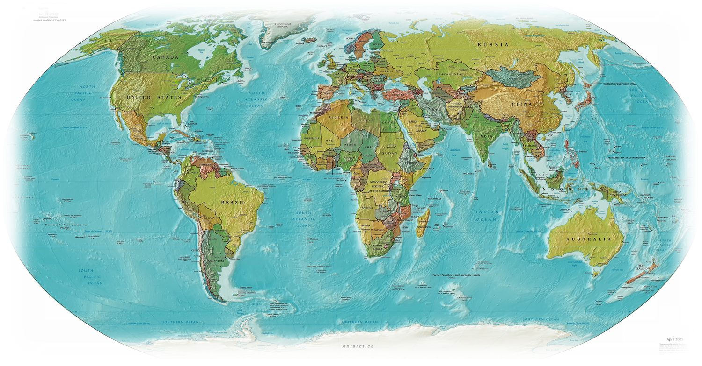
Differences between HERE and THERE
Who could you donate your 3Ts to? How could you do it?
Identify ways to make a local, national, and/or global impact.

Slide 3
PHILANTHROPY
WHAT WILL YOU DO?

