Slide 1
LESSON 3 - PERSONAL PASSIONS DRIVE YOUR MISSION
USE YOUR PASSIONS TO WRITE A MISSION STATEMENT

Slide 2
ALEX’S LEMONADE STAND
Foundation for childhood cancer
Use personal passions to work with like-minded peers to create philanthropic mission statements.

Slide 3
What are personal passions?
Use personal passions to work with like-minded peers to create philanthropic mission statements.

Slide 4
What are personal passions?
Strong feelings of enthusiasm or excitement for something or about doing something
Use personal passions to work with like-minded peers to create philanthropic mission statements.

Slide 5
Think for a moment about the following:
What do you do with your free time?
What do you like reading about or watching on TV?
What skills do you have? What are you good at?
Are you involved in any afterschool activities?
What would you enjoy doing even if you didn't get any reward for doing it?
What would you like to do if you knew you wouldn’t fail?
What comes easy to you?
When is a time in your life that you have felt the most creative and alive?

Slide 6
DISCUSSION QUESTIONS
What is a personal passion that you can use to help others?
Why is this personal passion important to you?
?
?
?
?
?
?
?
Use personal passions to work with like-minded peers to create philanthropic mission statements.

Slide 7
Let’s MIND MAP!!
WHAT IS A MIND MAP? A mind map can be used to help you visually organize information
Write your name in the center circle
Write down four of your personal passions and put them in the circles that branch off from the large center circle. What do you care a lot about?
Think up ways that you could fill a need or give back to your community for each passion using your 3Ts
Don’t forget to illustrate! Make this yours! Get creative!

Slide 8
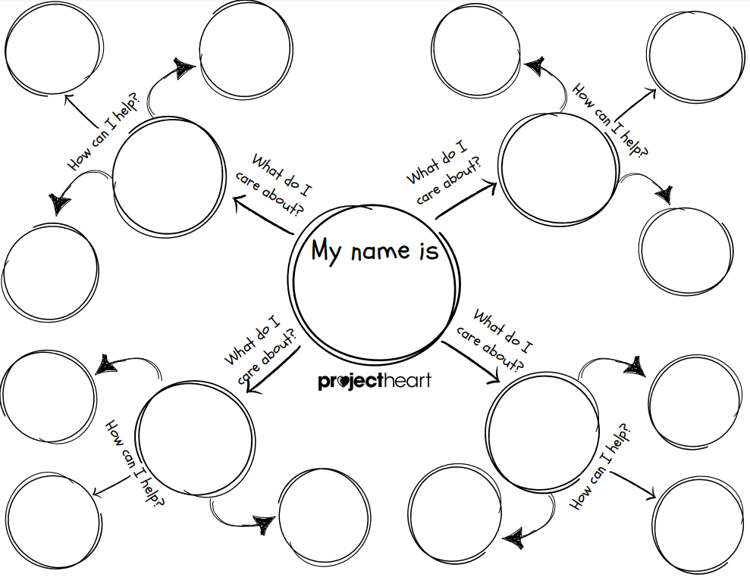

Slide 10
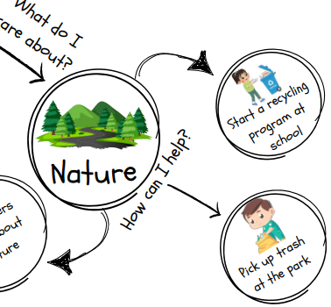
You can always write in more thoughts! What are some next steps you can take to help you fill that need?
How many people do I need to help me?
Make flyers and hang them up around the school
Who do I need to ask permission from to do this?
What park near me needs the most help?
Materials I need:
Bags
Gloves

Slide 11
MISSION STATEMENTS
A mission statement is short statement of why a person or organization exists - what their overall goal is, what kind of product, service or skill it provides, etc.
Both people and organizations can have mission statements!

Slide 12
WHO SAID THAT…
“With every cup, with every conversation, with every community - we nurture the limitless possibilities of human connection.”

Slide 13
WHO SAID THAT…
“With every cup, with every conversation, with every community - we nurture the limitless possibilities of human connection.”
STARBUCKS

Slide 14
WHO SAID THAT…
“To be the best sports brand in the world.”

Slide 15
WHO SAID THAT…
“To be the best sports brand in the world.”
ADIDAS

Slide 16
WHO SAID THAT…
“To save people money so they can live better.”

Slide 17
WHO SAID THAT…
“To save people money so they can live better.”
WALMART

Slide 18
YOU SAID THAT…
Decide what you want your mission statement to say about you…
Should be based on what you want to achieve and why
Should be short - 1-2 sentences
Should be based on what you’re good at or feel strongly about - think about your personal passions!
Should involve reflecting on how you want to be remembered
Should be a starting point to creating goals towards your dreams

Slide 19
YOU SAID THAT…
My mission is to (result of addressing a need) by (action you can take) so (result of the change).

Slide 20
YOU SAID THAT…
For example…
“My mission is to better the lives of shelter pets by volunteering one hour per week at my local animal shelter so that I can bring joy and happiness to animals that have been surrendered or neglected.”

Slide 21
YOU SAID THAT…
For example…
“My mission is to make a difference in the lives of others by sharing my life experiences and knowledge about diabetes so that we can bring more awareness to this condition.”

Slide 22
YOU SAID THAT…
My mission is to (result of addressing a need) by (action you can take) so (result of the change).

Slide 23
PHILANTHROPY
WHAT WILL YOU DO?

