Slide 1
LESSON 2 – HOW CAN YOU MAKE A DIFFERENCE WITH YOUR 3TS?

Slide 2
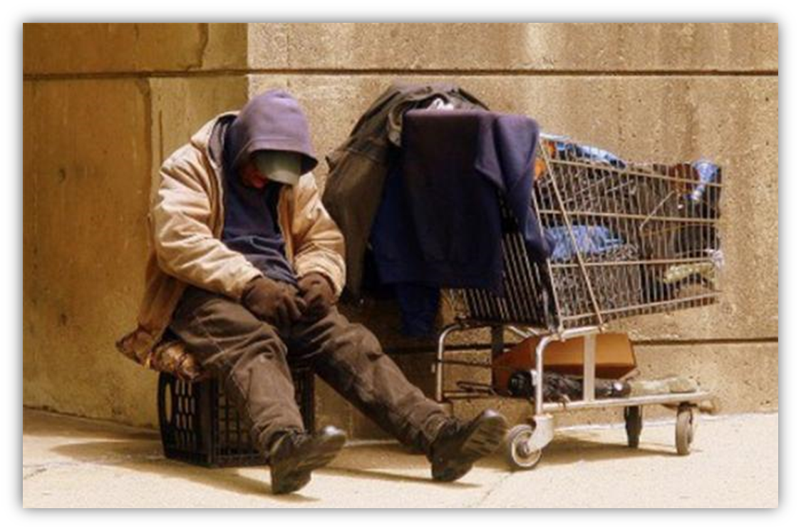
How could you donate your TIME, TALENTS, or TREASURES to make a difference in this person’s life?
Analyze how to use your 3T’s to help local non profits

Slide 3
WHAT IS A NONPROFIT OR NOT-FOR-PROFIT ORGANIZATION?
WHAT KINDS OF LOCAL RESOURCES ARE AVAILABLE?
A nonprofit, or not-for-profit, organizations are not “in business” to make money, but to give back to society in some way, making them exempt from certain taxes.
Homeless shelters | Housing resources
Nonprofits that offer free food | Clothing donation sites
Nonprofit organizations that help people find jobs

Slide 4
INCREASING YOUR POTENTIAL IMPACT
DISCUSSION QUESTIONS
Define philanthropy and explain, “Why Project Heart?”
Describe what giving looks like in daily life and in the community.

