Slide 1
LESSON 1 - WHAT DOES PHILANTHROPY MEAN IN YOUR LIFE?

Slide 2
How could you use your talents to make a difference in someone’s life?
Define philanthropy and explain, “Why Project Heart?”
Describe what giving looks like in daily life and in the community.

Slide 3
DISCUSSION QUESTIONS
Which experiences in your life drive you to want to help others?
How can you use your time, talents or treasure to help others?
?
?
?
?
?
?
?
Define philanthropy and explain, “Why Project Heart?”
Describe what giving looks like in daily life and in the community.

Slide 4
WHY IS PHILANTHROPY IMPORTANT?
Define philanthropy and explain, “Why Project Heart?”
Describe what giving looks like in daily life and in the community.
“One thing that I am walking away with from Project Heart is knowing that I helped someone and knowing that I impacted their life.”

Slide 5
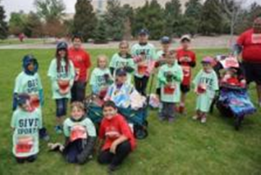
“PHILANTHROPY” AND “CHARITABLE FOUNDATIONS”
Philanthropy - The process of giving back. The act of donating money, goods, services, time or effort to support a beneficial cause and create a lasting impact.
Charitable Foundation - an organization that is created and supported with money that people give in order to do something that helps society.

Slide 6
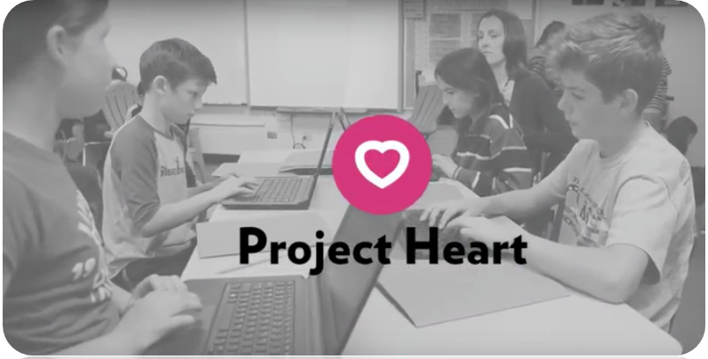
WHY PROJECT HEART?
The purpose of Project Heart curriculum is to create a habit of giving. If we affect people at a young age, it will have a positive impact on their lives and the community they live in. We believe this idea is life-changing and will ultimately create positive change.
How will you use your 3 T’s to make an impact for the common good?
WHAT
WILL YOU
DO?
Which organizations could you partner with to help more people?

