Slide 1
LESSON 10 - CELEBRATE AND CONTINUE YOUR EFFORTS
SHARE YOUR RESULTS AND STORIES OF IMPACT

Slide 2

IMPACT IS DOUBLE SIDED
How did your experience
IMPACT
YOU?
Present evidence of projects, reflect on the processes and outcomes, and plan for continued philanthropy.

Slide 3
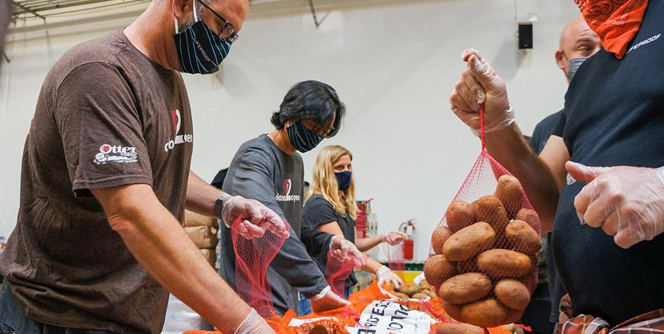
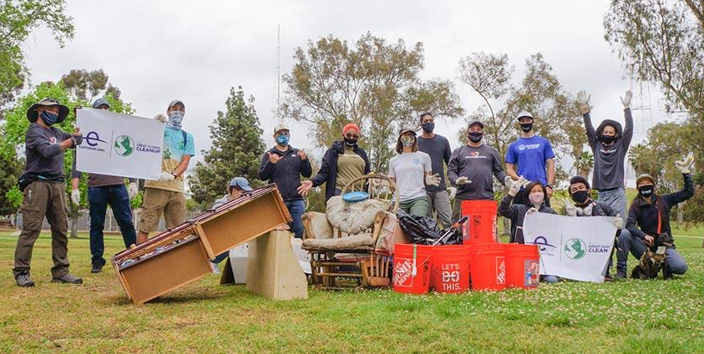
PHILANTHROPY
“You want to be the pebble in the pond that creates the ripple for change.”
-Tim Cook

