Slide 1
LESSON 7 -CREATE AN ACTION PLAN FOR SUCCESS

Slide 2
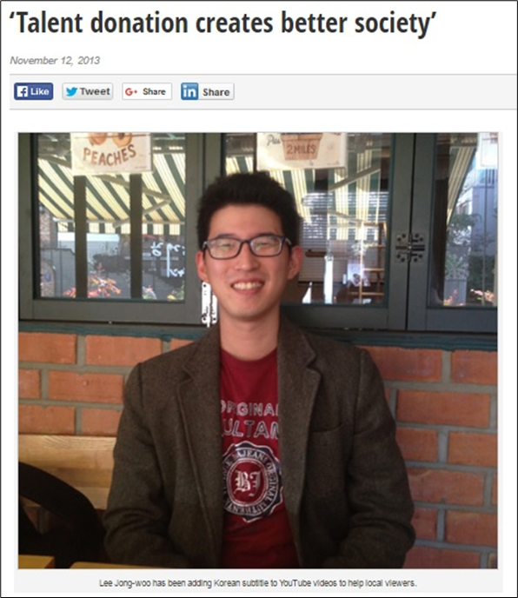
CREATE AN ACTION PLAN FOR SUCCESS
Lee Jon-woo started creating korean subtitles for motivational speeches on YouTube and Tedx Talk videos, so he can share the stories of motivational speakers to inspire people in his home country.
“I think each of us possesses a special talent. The important thing is how we use the talent to affect others and contribute to creating a better society.
Lee Jong-woo
Create action plans for reaching end goals for philanthropic effort despite obstacles. Document evidence of impact and gained experience in field of interest or career.

Slide 3
What are the goals for our project(s)?
HOW WILL YOU ACHIEVE YOUR GOALS?
Click to play, “Achieve More by Setting Smart Goals
Create SMART goals to improve the success of the project(s) and brainstorm ways to persevere despite obstacles

Slide 4
SMART goal example
S
pecific - I want to help five homeless families get connected to services so they can have access to the food and shelter they need.
easurable - I will know that I’m reaching my goal if all five of these families are utilizing the services.
ttainable - I already know the address of the some shelters in my area and I know how to communicate in a way that respects the dignity of the people I’d like to help
elevant - I know families who have struggled in the past and I know there’s a need in my community. This aligns with my vision of someday having a career in public service
ime-based - I want to have this goal accomplished in the next 3 months
M
A
R
T

Slide 5
FIND SUPPORT AND GET IT DONE!
COLLABORATE!!

