Slide 1
LESSON 4 - PHILANTHROPY WITH PURPOSE
WHAT DO YOU WANT TO DO? WHY DO YOU WANT TO DO IT?
CLICK TO PLAY!

Slide 2
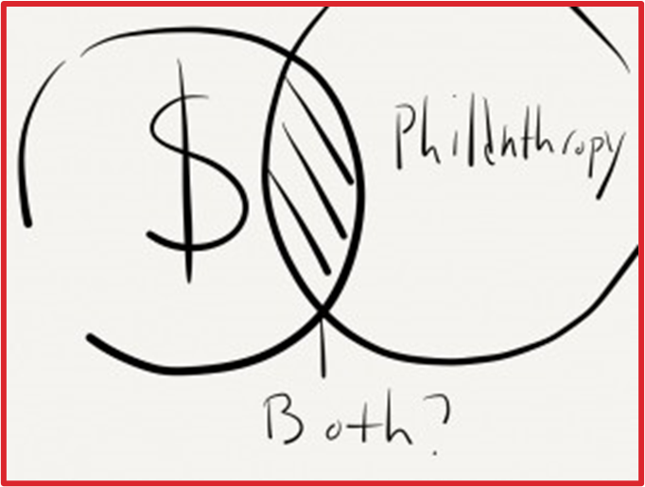
HOW WOULD YOU INVEST FOR SOCIAL IMPACT?
“Giving is deeply emotional. But supplementing emotion with research makes it more likely that a gift can have a bigger impact. It’s like any investment. You wouldn't put funds into stocks or bonds without understanding the potential return. Why wouldn’t you do the same when investing in society?”
-Laura Arrillaga Andreessen

Slide 3
WHAT IS YOUR PHILANTHROPIC MISSION?
Begin a personal pan of philanthropy by creating a mission statement. Use new knowledge about philanthropists, their purposes, and impact investing

Slide 4
WRITE YOUR MISSION STATEMENT
A general teaching mission may look like this: “My mission as a teacher is to help my students realize that through learning, they can enhance their life in a positive way. I want to help all of my students believe in themselves and through that belief, take on the challenge of life and go forward.
WHAT WILL YOU DO?

