Slide 1
LESSON 10 - CELEBRATE AND CONTINUE YOUR EFFORTS
SHARE YOUR RESULTS AND STORIES OF IMPACT

Slide 2
IMPACT IS DOUBLE SIDED
How did your experience
IMPACT
YOU?

Slide 3
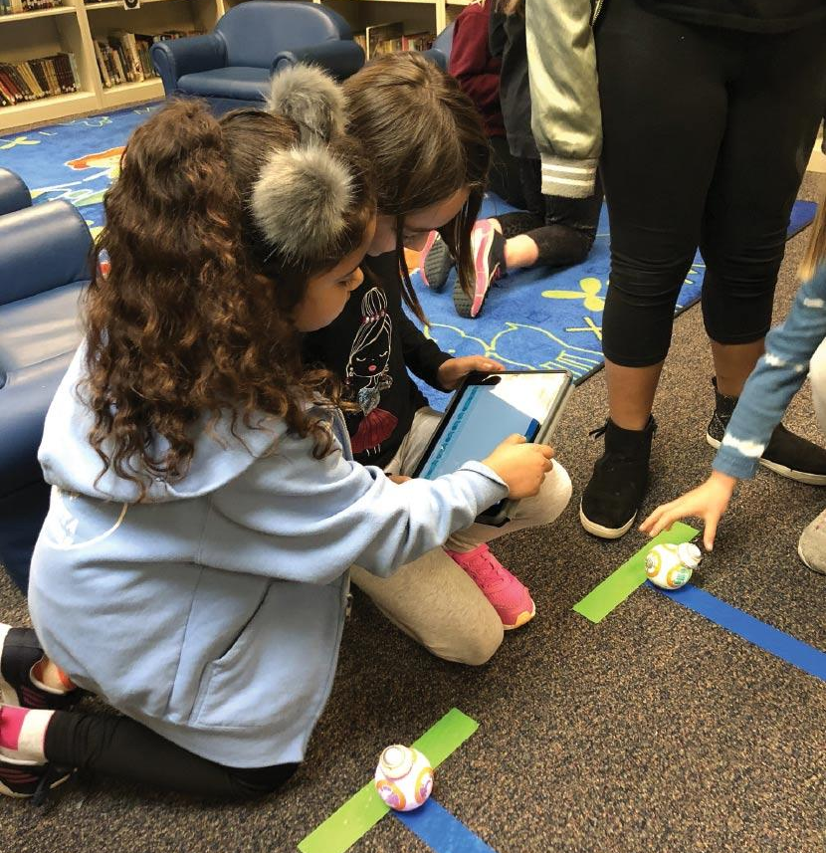
MEASURING SUCCESS
Use your self-created rubrics from Lesson 2 to have peers evaluate your philanthropic effort
Show off your project evidence
Share one highlight of how you were able to make an impact on someone and two ways YOU were personally affected by your project
What advice would you give to another student who wanted to replicate your project?

Slide 4
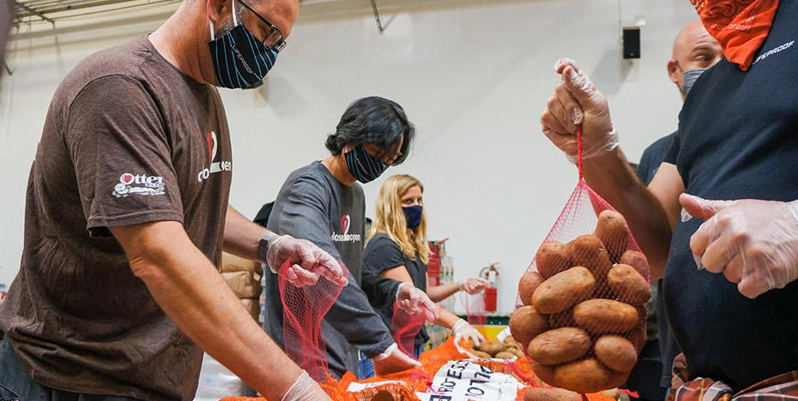
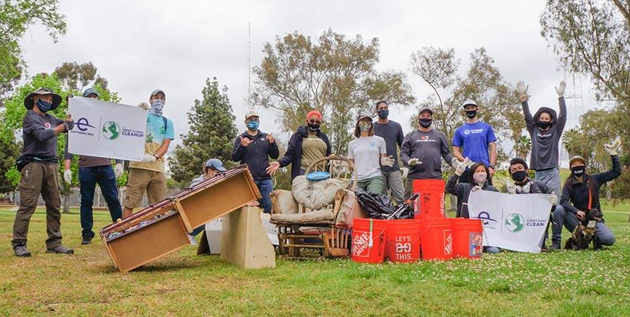
“Go into the world and do well. But more importantly, go into the world and do good.”
What’s your next philanthropic project?
-Minor Myers Jr.

