Slide 1
LESSON 3 - COMMUNITY BEFORE SELF

Slide 2
VOCABULARY
PHILANTHROPIST
PHILANTHROPY
3Ts
NEED
SERVICE
LOCAL
VOLUNTEER
GIVING
3Ts

Slide 3
VOCABULARY
PHILANTHROPIST
PHILANTHROPY
3Ts
NEED
SERVICE
LOCAL
VOLUNTEER
GIVING
3Ts

Slide 4
VOCABULARY
Someone who uses their 3Ts to give back and help others
PHILANTHROPY
3Ts
NEED
SERVICE
LOCAL
VOLUNTEER
GIVING
3Ts

Slide 5
VOCABULARY
PHILANTHROPIST
PHILANTHROPY
3Ts
NEED
SERVICE
LOCAL
VOLUNTEER
GIVING
3Ts

Slide 6
VOCABULARY
PHILANTHROPIST
Meeting needs for our common good. Giving back.
3Ts
NEED
SERVICE
LOCAL
VOLUNTEER
GIVING
3Ts

Slide 7
VOCABULARY
PHILANTHROPIST
PHILANTHROPY
3Ts
NEED
SERVICE
LOCAL
VOLUNTEER
GIVING
3Ts

Slide 8
VOCABULARY
Three things a philanthropist uses - time, talent and treasure
PHILANTHROPIST
PHILANTHROPY
NEED
SERVICE
LOCAL
VOLUNTEER
GIVING
3Ts

Slide 9
VOCABULARY
PHILANTHROPIST
PHILANTHROPY
3Ts
NEED
SERVICE
LOCAL
VOLUNTEER
GIVING
3Ts

Slide 10
VOCABULARY
PHILANTHROPIST
PHILANTHROPY
3Ts
Something a person must have
SERVICE
LOCAL
VOLUNTEER
GIVING
3Ts

Slide 11
VOCABULARY
PHILANTHROPIST
PHILANTHROPY
3Ts
NEED
SERVICE
LOCAL
VOLUNTEER
GIVING
3Ts

Slide 12
VOCABULARY
PHILANTHROPIST
PHILANTHROPY
3Ts
NEED
Doing something helpful to meet a need
LOCAL
VOLUNTEER
GIVING
3Ts

Slide 13
VOCABULARY
PHILANTHROPIST
PHILANTHROPY
3Ts
NEED
SERVICE
LOCAL
VOLUNTEER
GIVING
3Ts

Slide 14
VOCABULARY
PHILANTHROPIST
PHILANTHROPY
3Ts
NEED
A city, town or district rather than a large area.
SERVICE
VOLUNTEER
GIVING
3Ts

Slide 15
VOCABULARY
PHILANTHROPIST
PHILANTHROPY
3Ts
NEED
SERVICE
LOCAL
VOLUNTEER
GIVING
3Ts

Slide 16
VOCABULARY
PHILANTHROPIST
PHILANTHROPY
3Ts
NEED
A person who offers a service without getting anything in return
SERVICE
LOCAL
GIVING
3Ts

Slide 17
VOCABULARY
PHILANTHROPIST
PHILANTHROPY
3Ts
NEED
SERVICE
LOCAL
VOLUNTEER
GIVING
3Ts

Slide 18
VOCABULARY
PHILANTHROPIST
PHILANTHROPY
3Ts
NEED
SERVICE
LOCAL
VOLUNTEER
Sharing without expecting anything back.
3Ts

Slide 19
VOCABULARY
PHILANTHROPIST
PHILANTHROPY
3Ts
NEED
SERVICE
LOCAL
VOLUNTEER
GIVING
3Ts

Slide 20
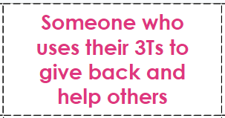
LET’S PLAY MEMORY!
Directions:
Match each vocabulary word with the correct definition
Delete or move the card covering two of the squares to see if you have found a match. If you haven’t, replace the cards and try again!
Once a match has been found, keep the vocabulary word and the definition visible so you can see what you have left to find
CARD
VOCABULARY WORD
DEFINITION

Slide 21
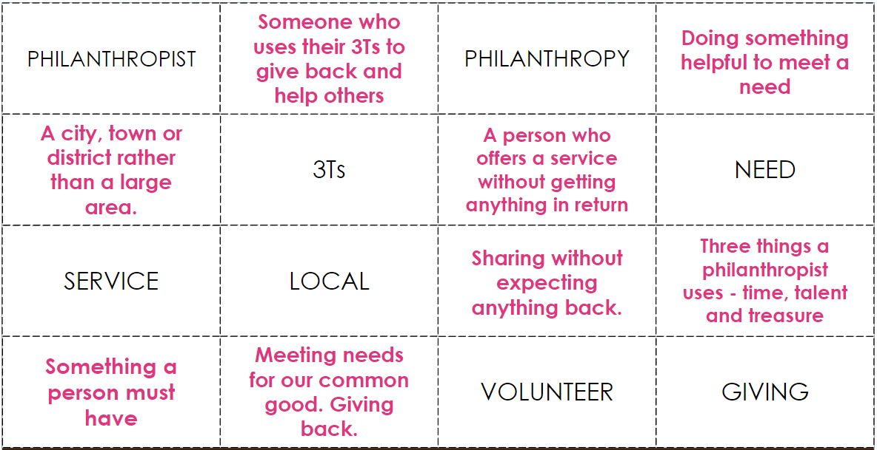

Slide 22
MEMORY GAME ANSWER KEY

Slide 23
PHILANTHROPIST
Someone who uses their 3Ts to give back and help others
PHILANTHROPY
Doing something helpful to meet a need
A city, town or district rather than a large area.
A person who offers a service without getting anything in return
3Ts
NEED
Three things a philanthropist uses - time, talent and treasure
SERVICE
LOCAL
Sharing without expecting anything back.
Something a person must have
Meeting needs for our common good. Giving back.
VOLUNTEER
GIVING

Slide 24
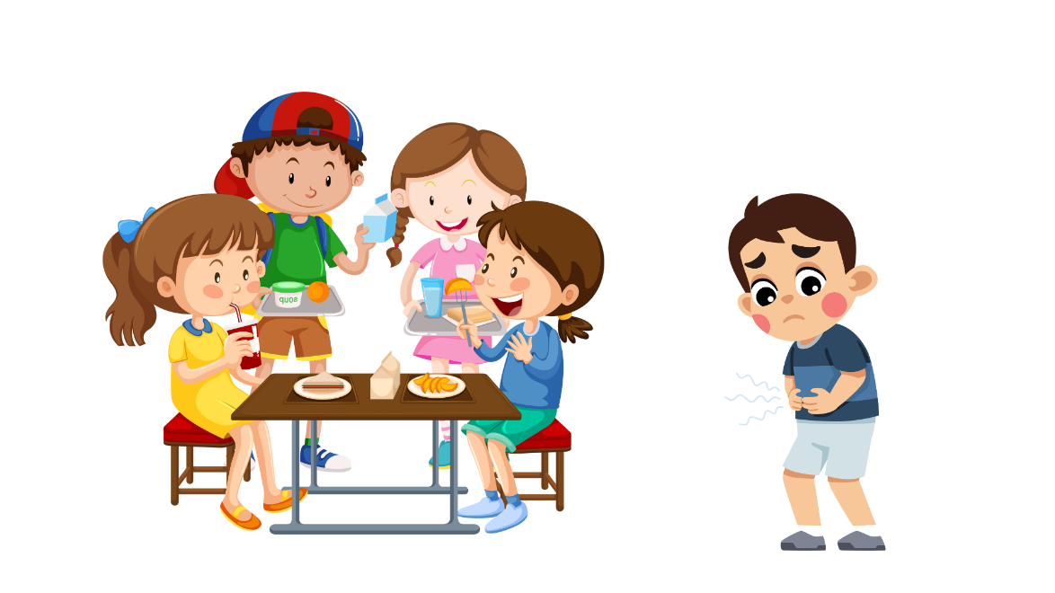
WHO NEEDS OUR HELP?

Slide 25
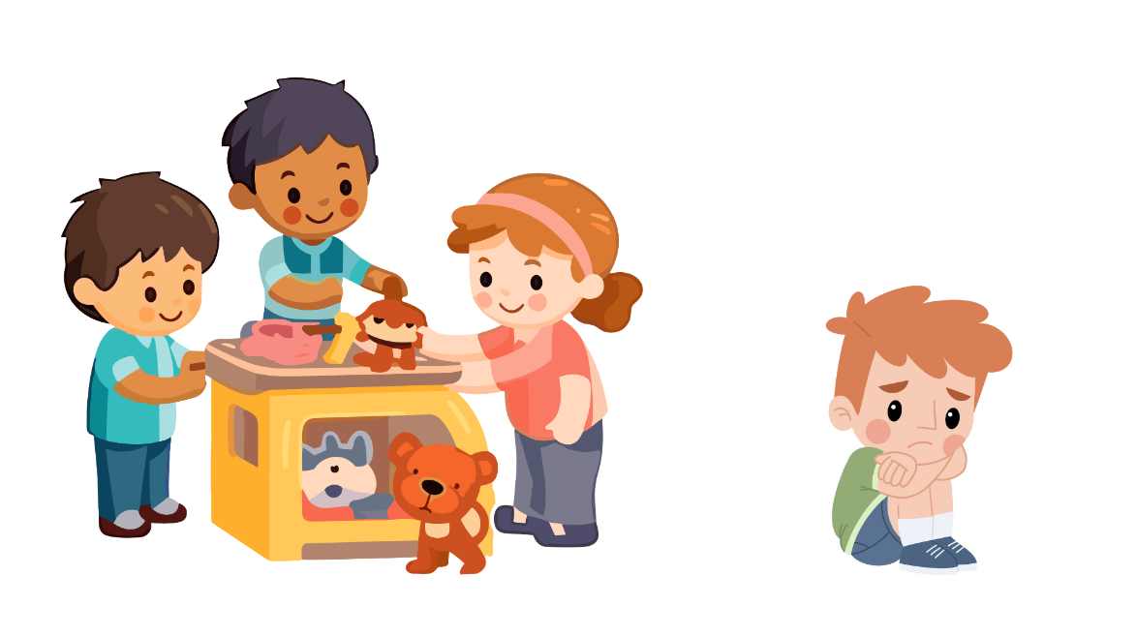
WHO NEEDS OUR HELP?

Slide 26
WHO NEEDS OUR HELP?

Slide 27
WHO NEEDS OUR HELP?

Slide 28
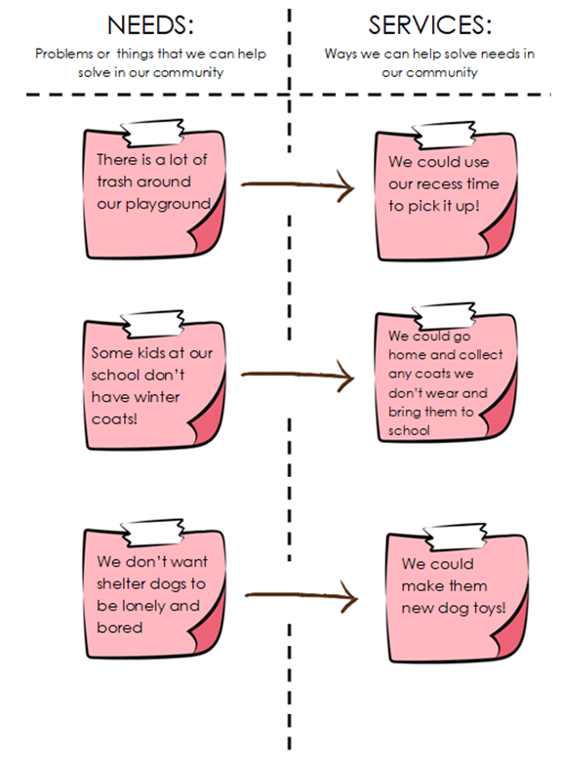
LET’S BRAINSTORM SOME NEEDS IN OUR COMMUNITY AND WAYS WE CAN HELP SOLVE THOSE NEEDS!

