Slide 1
LESSON 7 - CLASS SERVICE PROJECT
WHAT CAN WE DO?
Notes:
Standards and Teaching Notes
Philanthropy Objectives
Convince others to give time, talent and/or treasure towards a community need related to personal passions.
Create a list of ways to apply today’s learning about philanthropy to family, school and community.
Work with others to develop a plan of action to meet community needs.
Entrepreneurship Objectives
Analyze needs of communities and nonprofit organizations for the purpose of planning philanthropic efforts.
Anchor Standards
CCSS.ELA-LITERACY.CCRA.SL.1 Prepare for and participate effectively in a range of conversations and collaborations with diverse partners, building on others' ideas and expressing their own clearly and persuasively.
CCSS.ELA-LITERACY.CCRA.SL.4 Present information, findings, and supporting evidence such that listeners can follow the line of reasoning and the organization, development, and style are appropriate to task, purpose, and audience.
Common Core Standards
CCSS.ELA-LITERACY.SL.4.1.C Pose and respond to specific questions to clarify or follow up on information, and make comments that contribute to the discussion and link to the remarks of others.
CCSS.ELA-LITERACY.SL.4.1.D Review the key ideas expressed and explain their own ideas and understanding in light of the discussion.
CCSS.ELA-LITERACY.SL.5.1.C Pose and respond to specific questions by making comments that contribute to the discussion and elaborate on the remarks of others.
CCSS.ELA-LITERACY.SL.5.1.D Review the key ideas expressed and draw conclusions in light of information and knowledge gained from the discussions.
Economics Standards
Content Standard 6: Specialization
Division of labor occurs when the production of a good is broken down into numerous separate tasks, with different workers performing each task.
Specialization and division of labor usually increase the productivity of workers.
Social Studies Standards
Civic Ideals and Practices
Recognize and interpret how the “common good” can be strengthened through various forms of citizen action.
Global Connections
Investigate concerns, issues, standards, and conflicts related to universal human rights, such as the treatment of children, religious groups, and effects of war.
Teaching Notes
Teacher Might say: “Welcome! Today we are going to use our list of needs from last class, and we are going to decide on what specifically we can do as a class to help our recipient nonprofit meet that need.”

Slide 2
HOW TO CHANGE THE WORLD
Develop a plan for meeting the needs of a local nonprofit organization
Notes:
Teaching Notes
Play the video, “How to Change the World – a work in progress (Kid President)” found on PPT slide 2.
Ask students to give a thumbs-up or thumbs-down response to whether they agree with Kid President, then call on 3-4 students to respond to each of these questions:
Why doesn’t complaining or ignoring problems help to make the world better?
Why is it up to you instead of the smartest or most powerful people to change the world?
How can someone like you or me change the world?

Slide 3
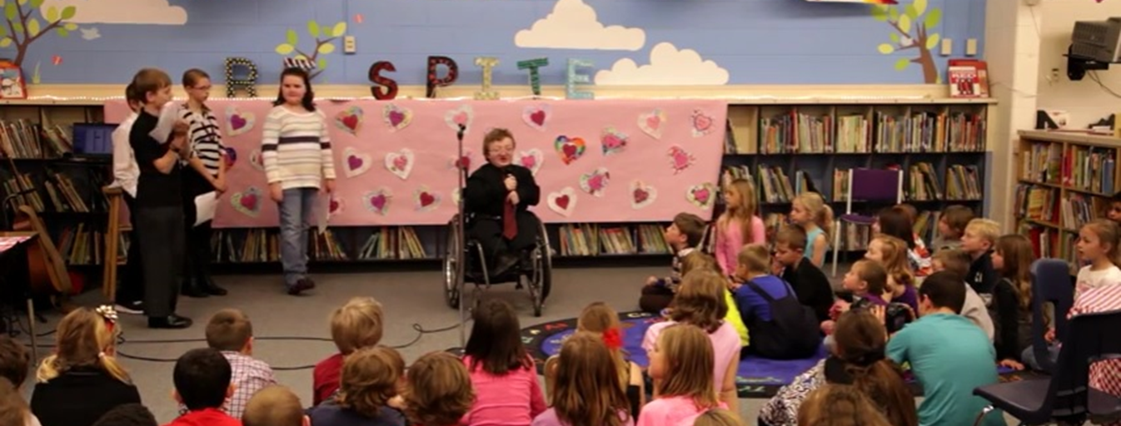
SERVICE PROJECT EXAMPLE: “Hearts for Respite” Class Project
What were the project goals?
What evidence of the 3 T’s did you see?
Develop a plan for meeting the needs of a local nonprofit organization
Notes:
Teaching Notes
Teacher introduces the project in the chosen video (choose between videos on PPT slides 3-5), and asks students to take notes on worksheet L7W1.
Play the chosen video.
After the video, teacher might ask, “What do you think the project goals were in the video?”
Call on a student to respond, then ask for a thumbs-up or thumbs-down response from the class to signal whether they agree with that answer. If not, call on 2-3 more until the class agrees with the student’s answer.
Repeat this process using the question: “What evidence of the 3 T’s did you see?”

Slide 4
SERVICE PROJECT EXAMPLE: “Alex’s Lemonade Stand”
What were the project goals?
What evidence of the 3 T’s did you see?
Develop a plan for meeting the needs of a local nonprofit organization
Notes:
Teaching Notes
Teacher introduces the project in the chosen video (choose between videos on PPT slides 3-5), and asks students to take notes on worksheet L7.W1.
Play the chosen video.
After the video, teacher might ask, “What do you think the project goals were in the video?”
Call on a student to respond, then ask for a thumbs-up or thumbs-down response from the class to signal whether they agree with that answer. If not, call on 2-3 more until the class agrees with the student’s answer.
Repeat this process using the question: “What evidence of the 3 T’s did you see?”

Slide 5
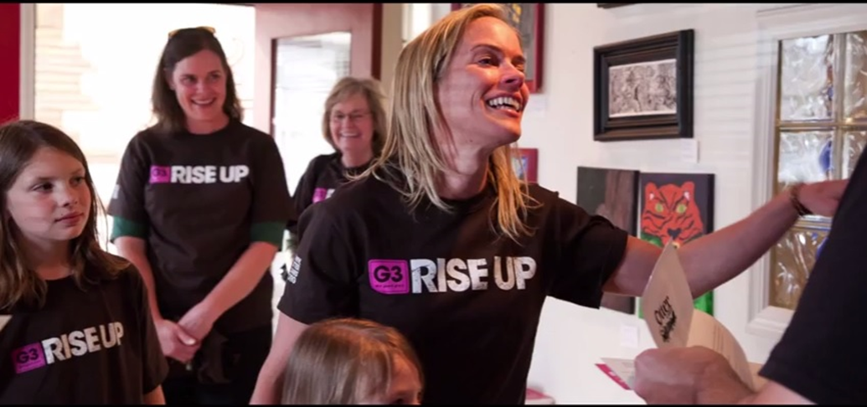
SERVICE PROJECT EXAMPLE: “The G3 Challenge”
What were the project goals?
What evidence of the 3 T’s did you see?
Develop a plan for meeting the needs of a local nonprofit organization
Notes:
Teaching Notes
Teacher introduces the project in the chosen video (choose between videos on PPT slides 3-5), and asks students to take notes on worksheet L7.W1.
Play the chosen video.
After the video, teacher might ask, “What do you think the project goals were in the video?”
Call on a student to respond, then ask for a thumbs-up or thumbs-down response from the class to signal whether they agree with that answer. If not, call on 2-3 more until the class agrees with the student’s answer.
Repeat this process using the question: “What evidence of the 3 T’s did you see?”

Slide 6
WHAT CAN WE DO?
What do we want to do for __________________________? They need __________________________________________________.
Brainstorm a list of class project ideas
List out the Pros and Cons of project ideas
Final selection of class project
Notes:
Teaching Notes
Teacher Might say: “Now that we’ve seen a good example of a project to help nonprofit organizations, we are going to decide on what kind of class project can help with the need we voted on last time for our recipient nonprofit.”
Ask for a student to remind the class of the nonprofit organization that the class has agreed to help (first blank line on PPT slide 6.) The PPT can be projected onto the board so that the student can write the name of the organization on the line. Otherwise, ask for an oral answer and this can be typed in by the teacher on the PPT slide.
Ask for a student to remind the class which need they voted on in the last class, and allow the student to write the need on the projected PPT slide (or teacher types it in.)
Lead a whole-group brainstorming session to come up with a list of project ideas to fill this need (call two students to one of the flipcharts in the front of the room and act as scribes, writing down all the ideas that the class comes up with. (tap PPT for Brainstorm fade-in)
When ideas are exhausted, go through each one and ask the class what the pros might be to taking on this project, and what the cons might be (call two other scribes to write down responses on a new flipchart page.) (tap PPT for Pros and Cons fade-in)
After pros and cons are listed, teacher should lead the final selection by student voting. (tap PPT for final selection fade-in)

Slide 7
DEVELOPING A PROJECT PLAN
SET a date or dates for your event
CREATE a Project Plan to list materials needed and determine your budget
LIST steps you will be taking to make the plan successful
DETERMINE who you will need to get help from and what specifically you need that person to do
HIGHLIGHT the deadlines for your project
Notes:
Teaching Notes
Teacher Might say: “Now that we know which organization we’re helping, which need we’re helping to meet and how we can help, we need to come up with a plan for how we will make this happen.”
Tap PPT for fade-ins (one at a time) and teacher will discuss these planning components with the class, recognizing their input:
[TEACHER TIP] Teacher can use the Project Planning form L7.R1-R4 to map out the details for each component listed in PPT slide 6 (or create one after the class creates the plan.) The notes for “Hearts for Respite” can be used as a sample to guide this discussion.
Date should provide enough time for the class project to be finished and useful to the nonprofit.
ALL materials should be listed with price range for each and a deadline date for when these should be purchased by.
Steps should be in chronological order, working from the end date back to the present, with deadline dates for each
When listing helpers and their tasks, identify students (or teacher) who will be responsible for contacting them.
Go back through the plan and highlight the deadline dates.
Make copies of the completed plan to distribute to students.

Slide 8
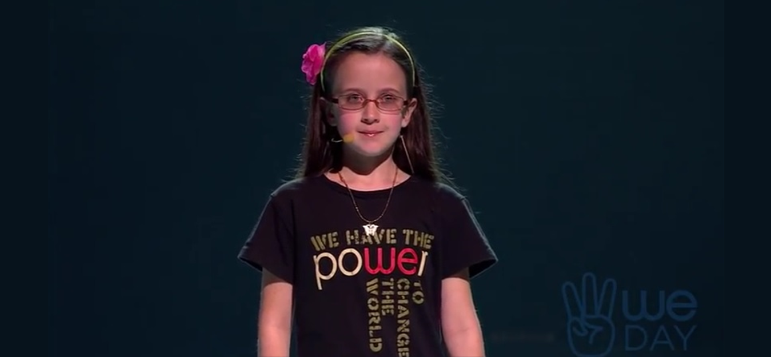
HOW WILL YOU CONTRIBUTE TO THIS CLASS PROJECT TO MAKE IT SUCCESSFUL?
Notes:
Teaching Notes
Play the inspirational video on PPT slide 8 to close the lesson.
Ask students to share with a partner how they will personally be able to use their 3 T’s in this class project.

