Slide 1
LESSON 5 - WRITING A MISSION STATEMENT

Slide 2
NEW VOCABULARY
Create a personal philanthropic mission statement
TERM | DICTIONARY DEFINITION
Common Good | Doing what is right or proper, the good belonging to or shared by each or all
Charity | Voluntarily giving help to those in need
Mission Statement | Description of the fundamental purpose of a group or organization; reason for existing
Local | Of or relating to a city, town or district rather than a larger area
National | Of or relating to a nation; common to or characteristic of a whole nation
Global | Of or relating to, or involving the entire earth; worldwide

Slide 3
“IT DOESN’T MATTER HOW FAST YOU ARE GOING IF YOU’RE HEADING IN THE WRONG DIRECTION.”
-Steven R. Covey
Create a personal philanthropic mission statement
What does this statement mean to you?

Slide 4
Mission Statements
Create a personal philanthropic mission statement
Mission statement: description of the fundamental purpose of a group or organization; a reason for existing.
OtterCares Inspiring students to become entrepreneurs and philanthropists
Humane Society To promote and provide the responsible care and treatment of animals

Slide 5
Look back at your list of PERSONAL PASSIONS to write your mission statement
Use your personal passions list from Lesson 4:
What needs from your list exist in your community?
What do you want to change based on those needs?
What would happen if you made those changes?
I will strive to _________________ (result of addressing need)
by ____________________________ (action you can take)
so _________________________________ (result of the change)
Does this mission connect to your passion?

Slide 6
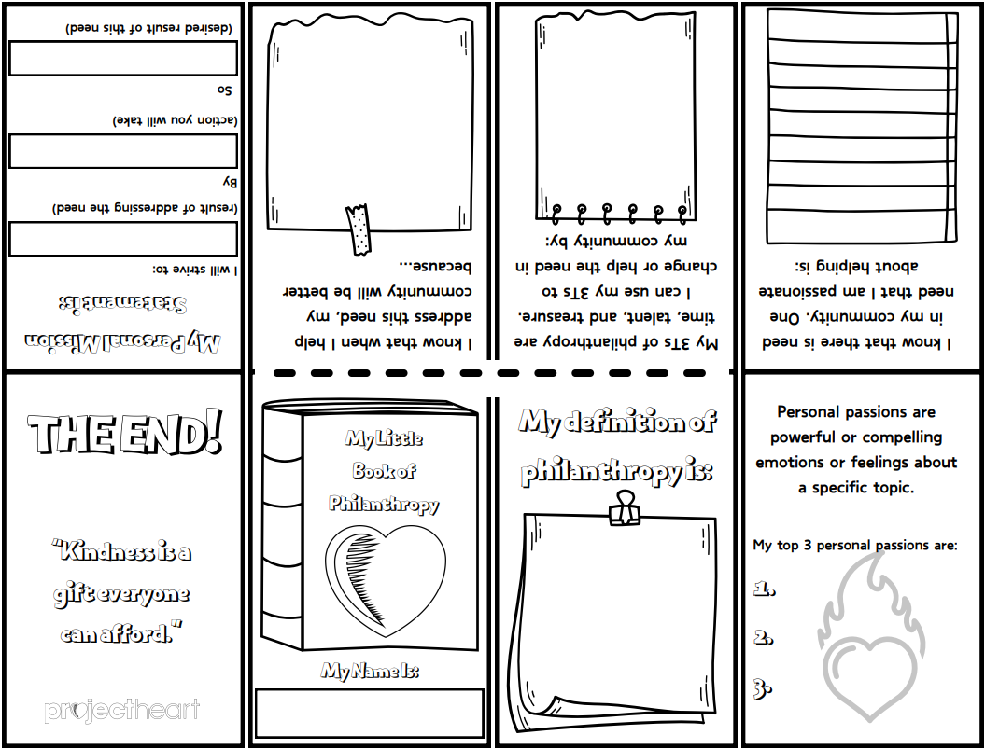
My Little Book of Philanthropy
Let’s make a pocket guide that we can carry around to help us remember a difference we can make in our communities!
https://youtu.be/TpqvTinDgVM?si=p0jWAUmw2pyvXOKe

Slide 7
My Little Book of Philanthropy
Fold and crease the paper along each line.
STEP 1

Slide 8
My Little Book of Philanthropy
Fold the paper in half and use scissors to cut just along the dotted line.
STEP 2

Slide 9
My Little Book of Philanthropy
Fold the paper in half long ways and push the two ends together so that the section you just cut opens.
STEP 3

Slide 10
My Little Book of Philanthropy
Fold the rest of the pages together so that you create a small book. Page 1 (My Little Book of Philanthropy) should be your title page.
STEP 4
7
6
5
4
8
1
2
3

Slide 11
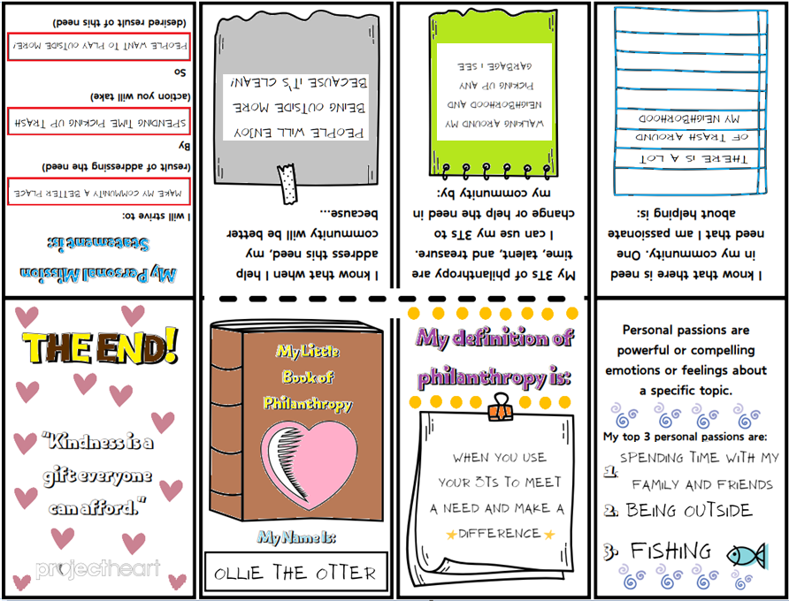
My Little Book of Philanthropy
Write on each page to make this book unique to YOU! Color using crayons or colored pencils to make it fun!
STEP 5

