Slide 1
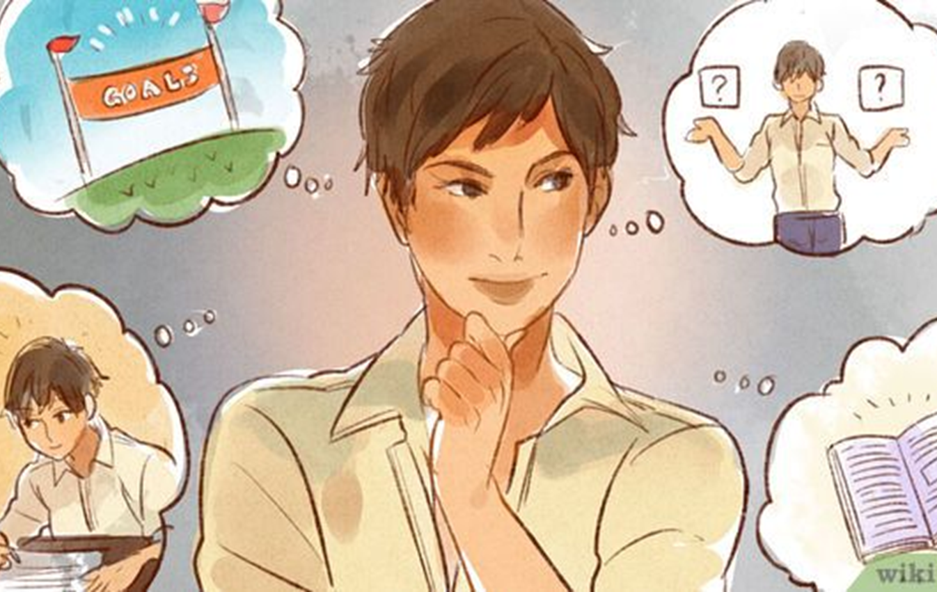
LESSON 4 - PERSONAL PASSIONS
Notes:
Standards and Teaching Notes
Philanthropy Objectives
Create a list of ways to apply today’s learning about philanthropy to family, school and community.
Convince others to give time, talent and/or treasure towards a community need related to personal passions (NEW.)
Entrepreneurship Objectives
Connect personal passions with philanthropists and community needs.
Anchor Standards
CCSS.ELA-LITERACY.CCRA.SL.3 Evaluate a speaker's point of view, reasoning, and use of evidence and rhetoric.
CCSS.ELA-LITERACY.CCRA.SL.1 Prepare for and participate effectively in a range of conversations and collaborations with diverse partners, building on others' ideas and expressing their own clearly and persuasively. Common Core Standards
Common Core Standards
CCSS.ELA-LITERACY.SL.4.1 and CCSS.ELA-LITERACY.SL.5.1
Engage effectively in a range of collaborative discussions (one-on-one, in groups, and teacher-led) with diverse partners on grade 4 topics and texts, building on others' ideas and expressing their own clearly.
CCSS.ELA-LITERACY.RL.5.4 Determine the meaning of words and phrases as they are used in a text, including figurative language such as metaphors and similes.
Economics Standards
Content Standard 14: Entrepreneurship
Entrepreneurs and workers often are innovative. They attempt to solve problems by developing and marketing new or improved products and processes.
Social Studies Standards
Culture
Give examples of how experiences may be interpreted differently by people from diverse cultural perspectives and frames of reference
Individual development and identity
Explore factors that contribute to one’s personal identity such as interests, capabilities, and perceptions.
Teaching Notes
Teacher Might Say: “Welcome! Today we are going to learn more about how WE can give to our community. We are going to start by talking about personal passions and then we will work to link our personal passions to community needs.”

Slide 2
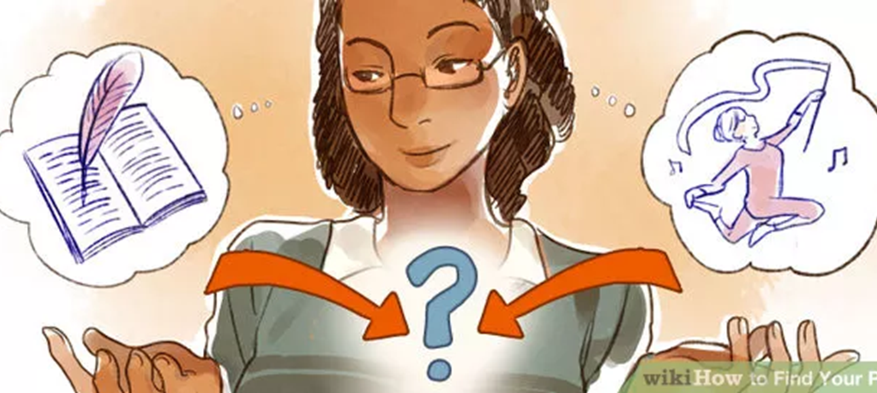
What is PERSONAL PASSION?
Dictionary definition Personal Passion - a powerful or compelling emotion or feeling about a specific topic.
Identify your personal passions and needs linked to that passion
Notes:
Teaching Notes
Ask students to share with a partner what they think a personal passion is. Allow about one minute for pair-sharing, and then call on several students to share their partner’s answer with the whole group.
Ask students to write what they think a “personal passion” is on their worksheet L4W1.
(tap PPT for fade-in) Personal Passion – a powerful or compelling emotion or feeling about a specific topic.
Ask students to write this definition of “personal passion” on their worksheet L4W1.

Slide 3
THINK BACK….
What were ________’s personal passions?
What were ________’s personal passions?
What were ________’s personal passions?
Identify the role of a philanthropist in a community
What are YOUR personal passions?
Which needs link to your passions?
Notes:
PPT Slide 3 - [TEACHER TIP] Teacher should fill the blanks on this slide with the name(s) of either guest speaker(s) or philanthropists from video PRIOR to class.
Teacher Might Ask, “Who remembers what __________________’s personal passion was (this slide correlates to Lesson 3 (either guest speaker(s) or videos about philanthropists.).
Ask students to review the definition of “need” from lesson one, and their interview sheet from lesson 3.
Call on students to respond to each philanthropist’s passion AND which need they are meeting (e.g. Nancy Richardson’s passion is education, and she is meeting the need of children who need school supplies.)
Give students more examples of passion and need by reading aloud at least two of the following, and then asking students to identify the passion and the need for each:
Holly Robinson Peete was an actress and has recently become a mother. Her son was diagnosed with autism, and she realized there is not much support for families of kids with autism. She and her husband formed the HollyRod Foundation, which offers support to families of people with autism and Parkinson’s disease.
Camille Zamora and Monica Yunus are opera singers who met at the Julliard School in New York. They have traveled around the world to sing, and now they have started a foundation, Sing for Hope, with which they hope to bring the arts back to underprivileged neighborhoods and schools.
John Melia is a marine who was injured in a helicopter crash in Somalia. Ten years later, Melia recognized that his fellow marines who get injured will need more support when they come back to the U.S. He founded the Wounded Warrior Project, which has helped thousands of wounded warriors so far.
Teacher Might say, “What these people have in common is that they were able to identify a need in their community and wanted to use their 3 T’s to meet that need.”
Tap for PPT for fade-in to prompt students to write their personal passions and linked needs.
Ask students to take about 5 minutes to write their personal passions and some needs that they could meet with these passions on their worksheet [L4W1].

Slide 4
Who has similar PERSONAL PASSIONS?
Which issue or need are you MOST passionate about? Choose ONE!
Make a list of needs linked to this common passion you share with others
Be ready to share!
Identify your personal passions and needs linked to that passion
Notes:
Teaching Notes
Teacher Might say: “We might have many passions, and the community has many needs. When we put our passion together with empathy, we end up with purpose. Take 1-2 minutes to choose which ONE passion and ONE need (related to that passion) is the MOST important to you. Please write these on sticky notes.”
Pass out sticky notes (one per student) and walk the room to support students while they write the passion(s) and needs that are MOST important to them from their list.
As students finish their sticky notes, ask them to share out their passion and need, so that they can sort them within “big umbrella” categories, such as: Environment, Animals, Youth & Families, Hunger and Homelessness, Seniors, Individuals with Disabilities, Health, etc.
Write these categories on different flipcharts or butcher paper, and ask students to put their sticky notes on the appropriate flipchart for their passion and need.
Tap PPT for fade-in of shortened directions for small group work.
Divide the students into as many groups as there are flipcharts with different categories, and direct student groups to separate areas of the classroom, and explain the instructions:
Group members will come up with a list of needs that connect to their group’s passions that are represented on sticky notes on their flipchart.
They will have ten minutes to come up with as many as possible.

Slide 5
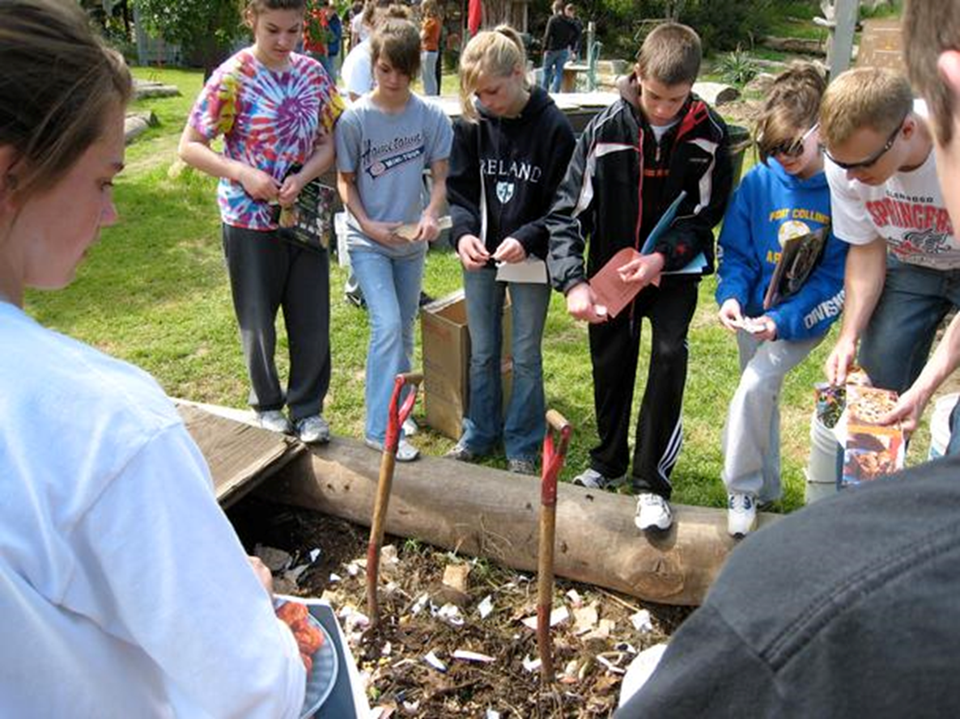
PHILANTHROPY
Notes:
Teaching Notes
Ask students to write down the issue or need they are most passionate about, one sentence explaining why, and what they could do to connect with this passion [L4W1].
[Optional Alternate Extension Activity and/or Homework] Students can use the quiz flashcards created in lesson 3, or create quiz flashcards as a review of the first four lessons, using their student workbooks to jog their memory of terms and concepts. They should write a question on the front of a ¼ sheet of paper, and then write the answer on the back. If there is time, give 30-second time frames for them to quiz a partner, then trade quiz cards, and switch partners. Repeat as many times as possible in remaining time.

