Slide 1
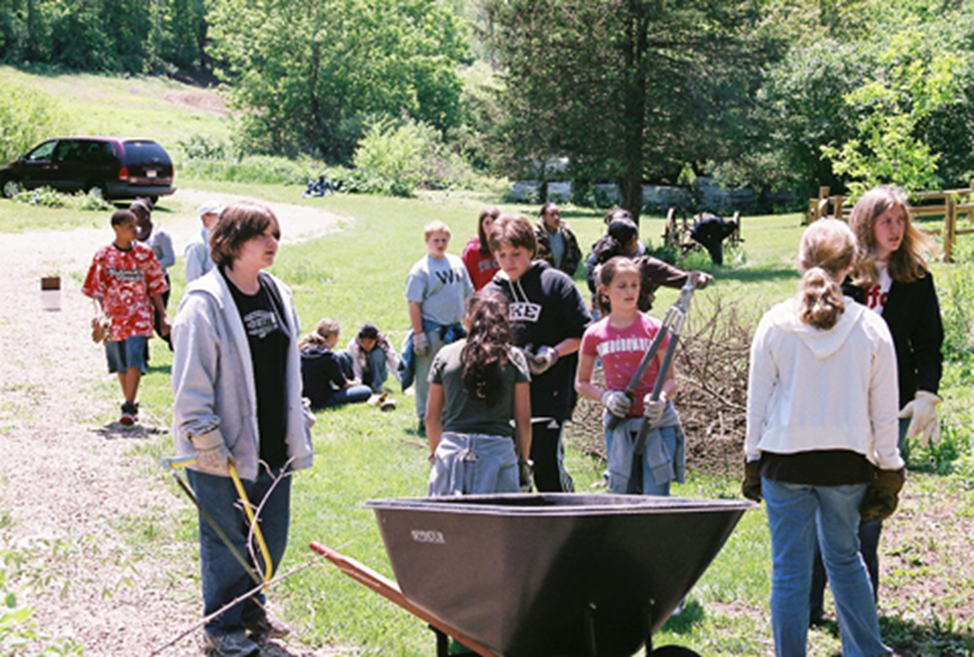
LESSON 3 - WHO GIVES IN THE COMMUNITY?

Slide 2
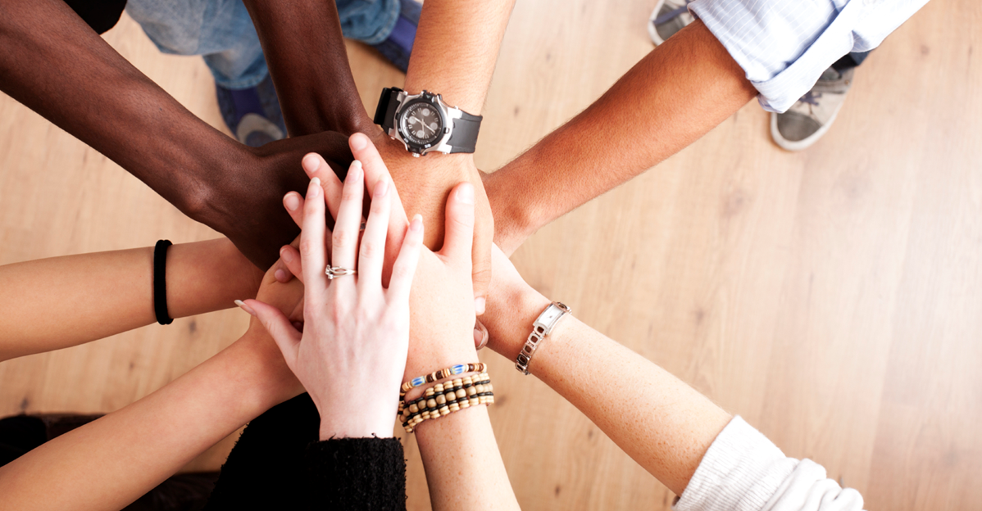
Understanding guest philanthropists
Discuss biographies in small groups
Discuss and select questions for the guests
Identify the role of a philanthropist in a community

Slide 3
RULES FOR THE VISIT
Students will be assigned questions
Take notes
Listen for key terms and big ideas
Learn as much as you can from this guest
Seek evidence of the 3 T’s
Identify the role of a philanthropist in a community

Slide 4
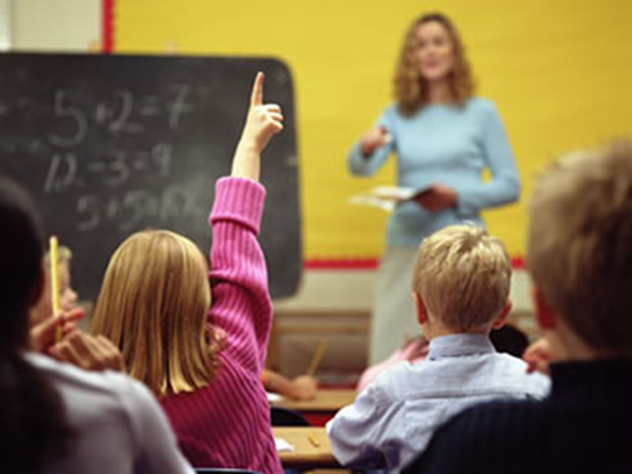
_____________ is a local philanthropist
What questions do you have for our guest?

Slide 5
RULES FOR THE VIDEOS
Listen for key terms and big ideas
Learn as much as you can from these philanthropists
Seek evidence of the 3 T’s
NANCY RICHARDSON
JEN & L.J. HOUSKA
KENNA CHRISTIAN

Slide 6
Nancy Richardson, Jen & L.J. Houska, and Kenna Christian are PHILANTHROPISTS.
Did the videos answer all of our questions?

Slide 7
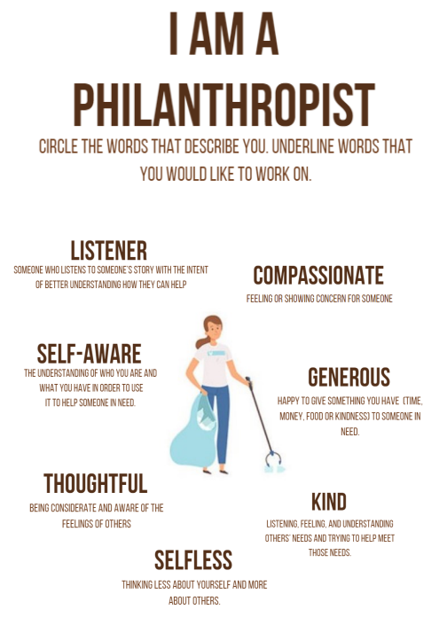
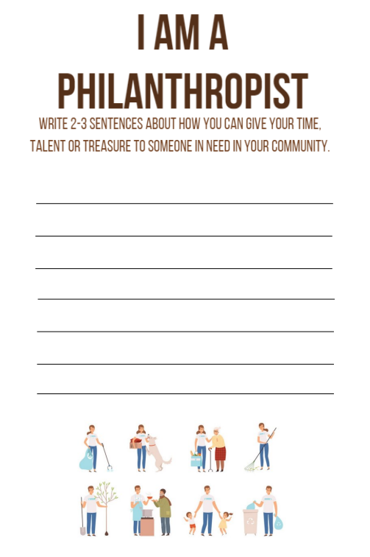
I AM A PHILANTHROPIST
Circle words that describe you. Underline what you would like to work on.
Write 2-3 sentences about how you can give your 3Ts to someone in need in your community.
FRONT
BACK

Slide 8
Reflecting on the 3T’s
Time
Talent
Treasure

