Slide 1
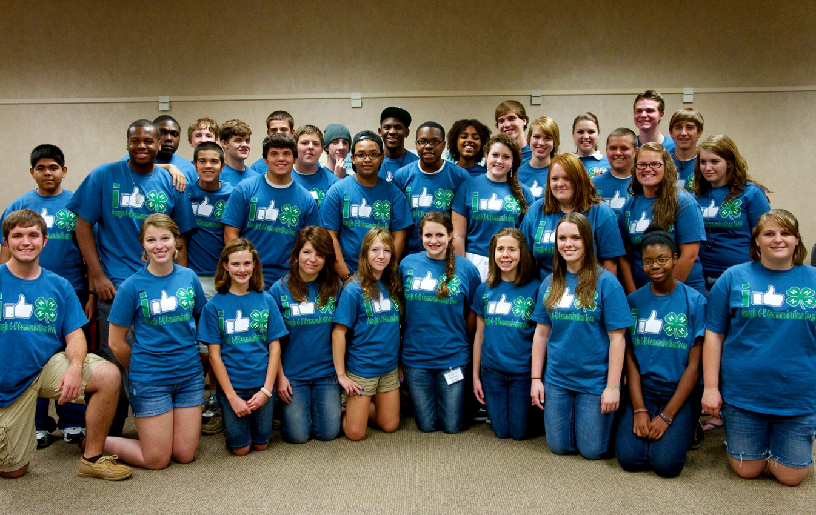
LESSON 2 - WHAT DOES PHILANTHROPY HAVE TO DO WITH YOU?
Notes:
Standards and Teaching Notes
Philanthropy Objectives
Create a list of ways to apply today’s learning about philanthropy to family, school and community.
Analyze local philanthropic efforts to deepen understanding of philanthropy.
Entrepreneurship Objectives
Evaluate the capability of a variety of local businesses to participate in philanthropy in the community.
Connect local philanthropic efforts to personal 3 T's (time, talent, treasure)
Anchor Standards
CCSS.ELA-LITERACY.CCRA.R.1 Read closely to determine what the text says explicitly and to make logical inferences from it; cite specific textual evidence when writing or speaking to support conclusions drawn from the text.
CCSS.ELA-LITERACY.CCRA.W.9 Draw evidence from literary or informational texts to support analysis, reflection, and research.
Common Core Standards
CCSS.ELA-LITERACY.RI.4.7 Interpret information presented visually, orally, or quantitatively (e.g., in charts, graphs, diagrams, time lines, animations, or interactive elements on Web pages) and explain how the information contributes to an understanding of the text in which it appears.
CCSS.ELA-LITERACY.SL.4.2 Paraphrase portions of a text read aloud or information presented in diverse media and formats, including visually, quantitatively, and orally.
CCSS.ELA-LITERACY.SL.5.2 Summarize a written text read aloud or information presented in diverse media and formats, including visually, quantitatively, and orally.
CCSS.ELA-LITERACY.L.4.4.C and CCSS.ELA-LITERACY.L.5.4.C Consult reference materials (e.g., dictionaries, glossaries, thesauruses), both print and digital, to find the pronunciation and determine or clarify the precise meaning of key words and phrases.
Economics Standards
Content Standard 10: Institutions
Not-for-profit organizations are established primarily for religious, health, educational, civic, or social purposes and are exempt from certain taxes.
Social Studies Standards
People, Places, & Environments
Consider existing uses and propose and evaluate alternative uses of resources and land in home, school, community, the region, and beyond.
Teaching Notes
Ask students to share with a partner what they remember about last class’s lesson related to:
Philanthropy
Needs
Service
Giving
Three T’s
Allow 3-4 minutes of partner sharing, and then call on several students to share their partner’s response to one of the key words listed.
Teacher Might say: “Today we are going to build on what we learned in our last class. We’re going to talk about more specific forms of philanthropy, as well as examples of philanthropy in communities.”
Display three posters on the wall each labeled with a different vocabulary word: nonprofit, charitable foundation, volunteer.
Distribute vocabulary strips (L2R1). Provide one strip per student.
Ask students to look at their vocabulary strip on their desk and go to the poster on the wall that they think matches their definition. Allow about 30 seconds for students to find their poster.
With students at their respective posters, ask them to discuss with their group what they know about their poster word (i.e. charitable foundations, nonprofits, volunteer) related to philanthropy. They should write their ideas on their group poster.
Allow 1-2 minutes for small group discussion, then call on 1-2 students per group to share responses.

Slide 2
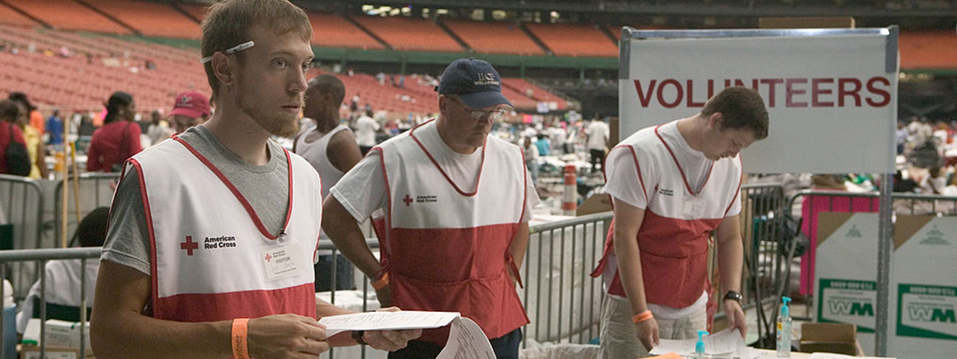
What do you know about CHARITABLE FOUNDATIONS?
Charitable Foundation - An organization that is created and supported with money that people give in order to do something that helps society.
Explain how philanthropy affects you and your community
Notes:
Teaching Notes
Teacher might say: “Let’s break this down. What do you know about the word ‘charity’ or the word ‘foundation’? What do you think it means when we bring them together?”
(tap PPT for fade-in) Charitable Foundation - an organization that is created and supported with money that people give in order to do something that helps society.
Determine with the class if the word break-down discussion came close to the dictionary definition.
Allow students 1-2 minutes to write their own definition of “charitable foundation” in their Student Workbook (L2V1).

Slide 3
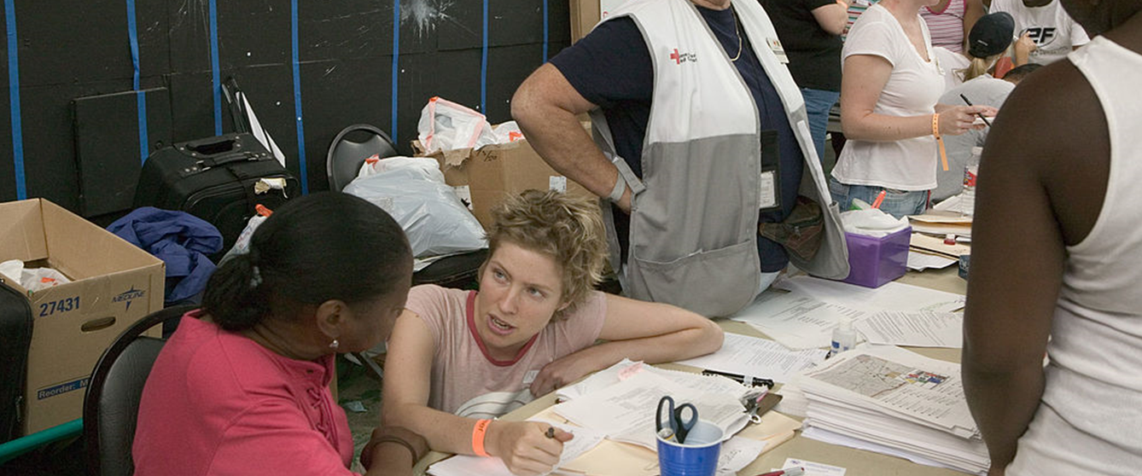
What do you know about NONPROFITS?
Nonprofit - An organization whose purpose is something other than making a profit.
Explain how philanthropy affects you and your community
Notes:
Teaching Notes
Continue vocabulary activity with:
Nonprofit – an organization whose purpose is something other than making a profit. (tap PPT for fade-in)
Allow students 1-2 minutes to write their own definition of “non-profit” on their worksheet.

Slide 4
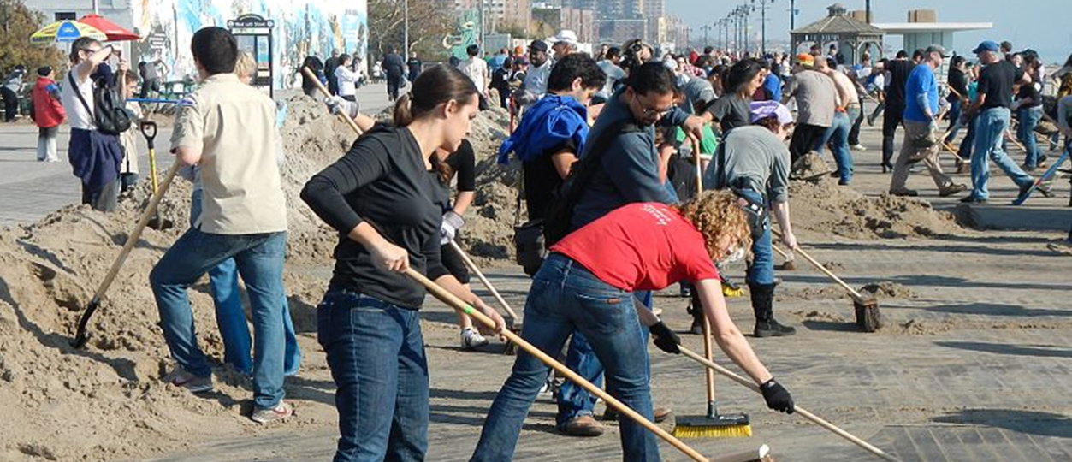
What do you know about VOLUNTEER?
Volunteer - A person who willingly offers him or herself to do some service without getting paid.
Explain how philanthropy affects you and your community
SYNONYM: PHILANTHROPIST
Notes:
Teaching Notes
Continue vocabulary activity with:
Volunteer - a person who willingly offers him or herself to do a service without getting paid. (tap PPT for fade-in)
Allow students 1-2 minutes to write their own definition of “volunteer” on their worksheet.
Call on 5-6 students to think of a synonym for volunteer. Tap PPT for fade-in “Philanthropist.”

Slide 5
WE WILL BE RESEARCHING NONPROFITS WHO ARE MEETING NEEDS IN COMMUNITIES
Group 1 - StandUp For Kids
Group 2 - Kaboom
Group 3 - OtterCares
Group 4 - My Stuff Bags Foundation
Group 5 - Alex’s Lemonade Stand
Group 6 - Food Recovery Network
Group 7 - Hoops of Hope
But first….
Notes:
Teaching Notes
Teacher might say: “We’re going to take a few minutes to find out more about nonprofit organizations, and to research some charitable foundations and volunteer opportunities. We will be looking for answers to these big questions”:
What is the mission statement?
Who do these nonprofits serve?
What community needs are they meeting?
How are they meeting these needs?
(for groups that finish early) What else did you find out about this organization?
Divide students into 7 groups of three with one reader, one recorder and one speaker.
Explain that each group will research one of the following sources to answer questions (NOTE: teacher needs to share the links with their students ahead of time so groups can access the sites once assigned, or pre-load the links onto student devices):
Group 1 - StandUp For Kids
Group 2 - Kaboom
Group 3 - OtterCares Group 4 - My Stuff Bags Foundation
Group 5 - Alex’s Lemonade Stand
Group 6 - Food Recovery Network
Group 7 - Hoops of Hope
[TEACHER TIP] Teacher may replace these national organizations with known local organizations.
Explain that the reader is in charge of reading the information aloud to their group, the writer will write the information down on their L2W1 worksheet, and the speaker(s) will share their findings with the class.
(tap PPT to fade-in) But first…
Once groups have found their website, show PPT Slide 7 to refer to the questions they need to answer.

Slide 6
…let’s research together!
Nonprofit -The Humane Society
Research Questions
1.What is the mission statement?
Celebrating animals. Confronting Cruelty.
2.Who do these nonprofits serve?
Animals and animal shelters
3.What community needs are they meeting?
Providing care, rescue, and services for animals in crisis
4.How are they meeting these needs?
Help to pass laws that protect animals
Notes:
Teacher Notes
Teacher will model the process of inquiry while researching at The Humane Society website.
(tap PPT to fade in) Nonprofit – The Humane Society
(tap PPT to fade in) each of the following questions, followed by a suggested answer
What is the mission statement? Celebrating animals. Confronting Cruelty.
Who do these nonprofits serve? Animals and animal shelters
What community needs are they meeting? Providing care, rescue, and services for animals in crisis
How are they meeting these needs? Help to pass laws that protect animals
(for groups that finish early) What else did you find out about this organization? The Humane Society provides direct care to more than 100,000 animals each year.

Slide 7
RESEARCH WHAT SOME NONPROFITS ARE DOING IN COMMUNITIES
Group 1 - StandUp For Kids
Group 2 - Kaboom
Group 3 - OtterCares
Group 4 - My Stuff Bags Foundation
Group 5 - Alex’s Lemonade Stand
Group 6 - Food Recovery Network
Group 7 - Hoops of Hope
Research Questions:
What is the mission statement?
Who do these nonprofits serve?
What community needs are they meeting?
How are they meeting these needs?
Notes:
Teaching Notes
Once groups have found their website, students can refer to the questions on PPT Slide 7 to help them answer the questions.
Close this activity by calling on the speaker in each group to present their findings to the class (1-2 minute presentations).
Teacher (or volunteer student) can write responses on the board (or project PPT slide 7)
[Optional Alternate Extension Activity – w/o technology, whole group]
This can be a whole group activity, in which the teacher projects these websites and prompts discussion with questions about how the purpose of each nonprofit, why it was founded, and volunteer opportunities.

Slide 8
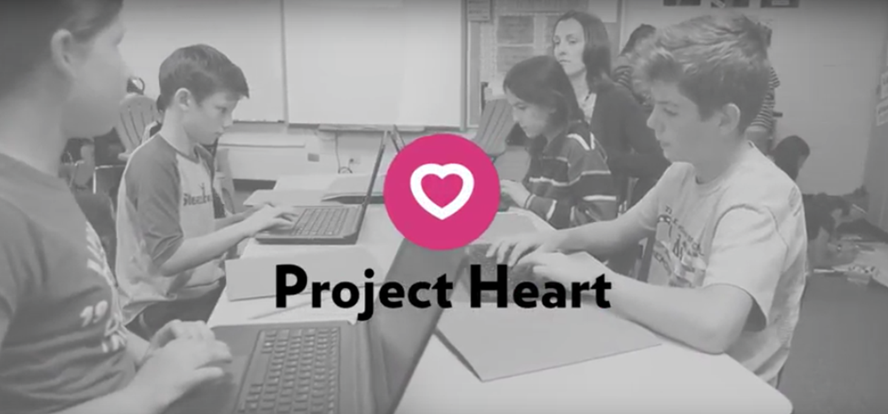
PHILANTHROPY - WHAT WILL YOU DO?
Notes:
Teaching Notes
Ask students to write a need in the community, explain why it is a need, and how they could give of their time, talent and/or treasure, using the bottom their worksheets (L2W1 – Exit Ticket).
Close the lesson by thanking students for their thoughtful ideas and participation, and ask them to discuss with a parent or guardian an issue that they would like to work together on. They will report on this in the next class.
[Optional Alternate Extension Activity – in class] Students can write, or draw and label, a need in the community onto ¼ sheets of paper to create a class collage.
[Optional Alternate Extension Activity – at home] Students can share with parent or guardian what type of nonprofit they would create to meet a need in their community.

