Slide 1
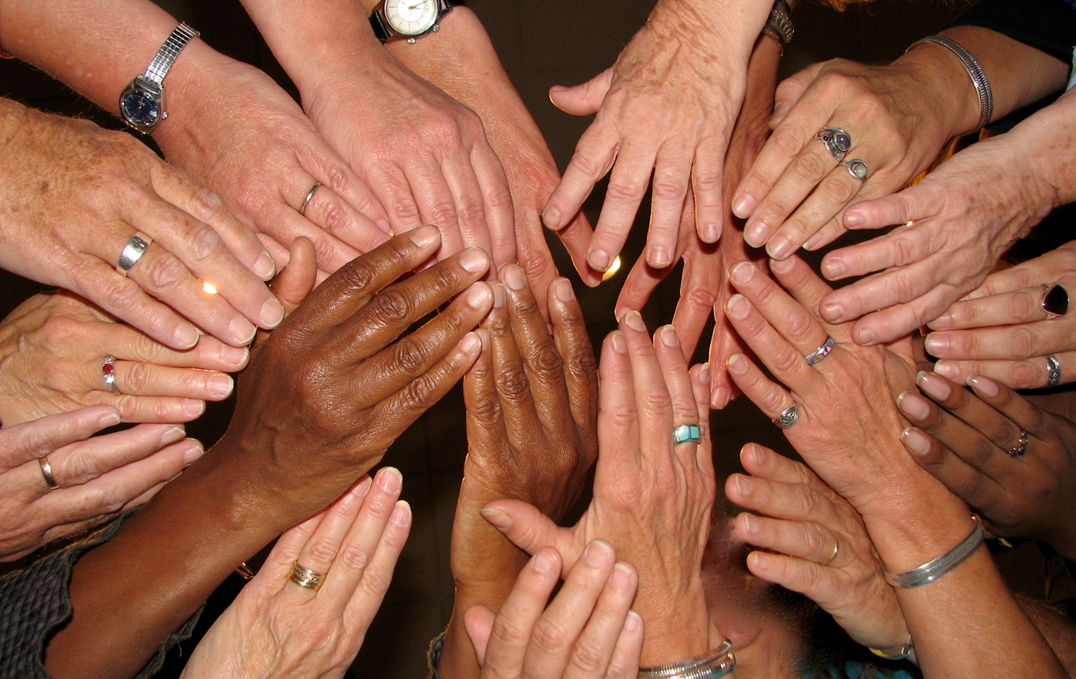
LESSON 1 - PHILANTHROPY - WHAT IS IT?
Notes:
Standards and Teaching Notes
* Students should complete the Pre-Assessment prior to this lesson (L1.A1)
* Teacher should use the Grading KEY for the Pre-Assessment (L1.A2)
Philanthropy Objectives
Create a list of ways to apply today’s learning about philanthropy to family, school and community.
Entrepreneurship Objectives
Evaluate the capability of a variety of local businesses to participate in philanthropy in the community.
Anchor Standards
CCSS.ELA-LITERACY.CCRA.SL.2 Integrate and evaluate information presented in diverse media and formats, including visually, quantitatively, and orally.
CCSS.ELA-LITERACY.CCRA.L.4 Determine or clarify the meaning of unknown and multiple-meaning words and phrases by using context clues, analyzing meaningful word parts, and consulting general and specialized reference materials, as appropriate.
Common Core Standards
CCSS.ELA-LITERACY.SL.4.1 and CCSS.ELA-LITERACY.SL.5.1
Engage effectively in a range of collaborative discussions (one-on-one, in groups, and teacher-led) with diverse partners on grade 4 topics and texts, building on others' ideas and expressing their own clearly.
CCSS.ELA-LITERACY.RL.5.4 Determine the meaning of words and phrases as they are used in a text, including figurative language such as metaphors and similes.
Economics Standards
Content Standard 1: Scarcity
Identify what they gain and what they give up when they make choices.
People make choices because they can’t have everything they want.
Identify some choices they have made and explain why they had to make a choice.
Social Studies Standards
Individual Development and Identity
Describe personal connections to place—especially place as associated with immediate surrounding.
Analyze a particular event to identify reasons individuals might respond to it in different ways.
Production, Distribution, Consumption
Distinguish between needs and wants
Teacher Might say: “Welcome! Today we are going to learn about giving to others. We are going to start by giving something to our classmates. You will all receive a blank ¼ sheet of paper, and what I would like you to do is write something sincere and kind on it, to give to a classmate. Try to be specific and encouraging to each other in these notes. These are your gift to them today!”
Pass out ¼ sheets of blank paper, one per student, and ask students to find a partner sitting near them.
When each student has a partner, allow about thirty seconds for them to write something kind about their partner. (If there is an odd number of students, then make one group of three and make sure each student in the triad is writing a note to a different child in their group.)
After one minute, ask students to give their note to their partner, then call on 3-4 to read their gift/note.

Slide 2
What do you know about GIVING?
How does it feel to give?
How does it feel to receive?
DICTIONARY DEFINITION Giving - to present voluntarily and without expecting compensation.
In your own words, define and reflect on the meaning of philanthropy
Notes:
Teaching Notes
Brainstorm what they know about giving, while a volunteer student writes responses on the board.
Ask students to pair-share to the following questions:
(tap PPT for fade-in) How does it feel to give?
(tap PPT for fade-in) How does it feel to receive?
Ask students to think about how their answers match up with the definition of “giving."
(tap PPT for fade-in) Giving - to present voluntarily and without expecting compensation.
Ask students to write their own definition of “giving” in their Student Workbook L1V1 (lesson 1 words included).
Allow 1-2 minutes for students to write their definition of “giving."
[Alternate Extension Activity] Use colored 5” squares of paper to have each student write words, definitions or examples of “giving”, and make a collage or class bulletin board titled “Giving” to display, then write the dictionary definition at the top. This would allow for a more permanent reminder of the work done around giving, while providing a group project that lends itself to sharing and building relationships with each other.

Slide 3
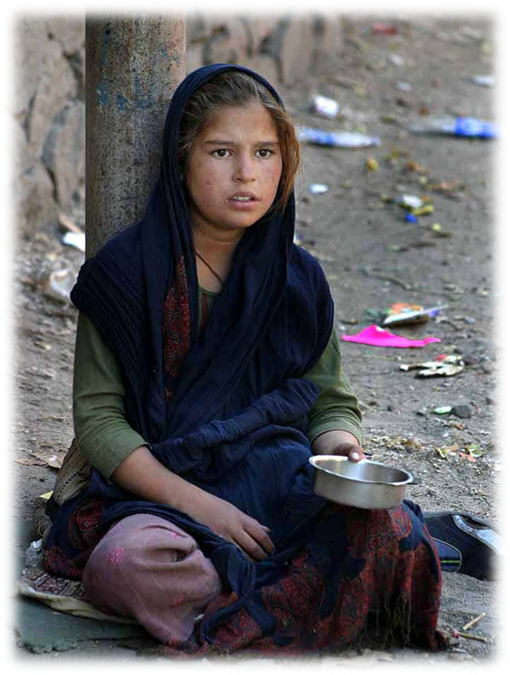
What do you know about NEED?
DICTIONARY DEFINITION Need - to require, to be necessary
In your own words, define and reflect on the meaning of philanthropy
Notes:
Teaching Notes
In a pair-share, ask students to talk about what they know about need.
Ask students to think about how their answers match up with the definition of “need."
(tap PPT for fade-in) Need - to require, to be necessary. Picture will appear.
Ask students to write their own definition of “need” on their Student Workbook L1V1 (lesson 1 words included).
Allow 1-2 minutes for students to write their definition of “need."
Teacher might ask, “Did you NEED to receive this little note from a classmate today?”

Slide 4
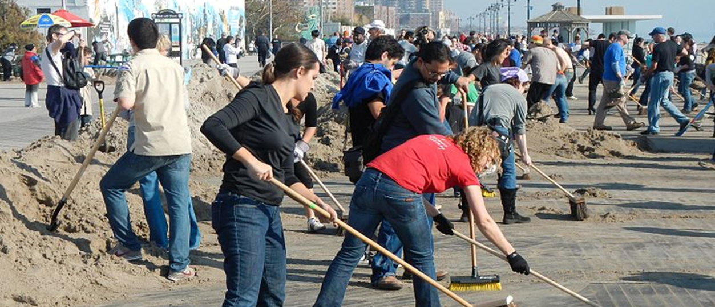
What do you know about SERVICE?
DICTIONARY DEFINITION Service - the act of helpful activity
In your own words, define and reflect on the meaning of philanthropy
Notes:
Teaching Notes
Teacher might say: “You are all capable of great things in your lives, and it’s up to you to choose HOW you will use your talents and passions to serve others in your family, school and community.”
Call on 3-4 students to share what they know about “service.”
(tap PPT for fade-in) Service: The act of helpful activity.
Ask students to write their own definition of “service” in their Student Workbook L1V1 (lesson 1 words included).
[TEACHER TIP] During small group work, use soft music and then pause when time is up.

Slide 5
What do you know about NEEDS of Families, Schools and Communities?
Needs
Service/What would help?
Families (groups 1-2):
Schools (groups 3-4):
Communities (groups 5-6):
Notes:
Teaching Notes
*Note to teacher – Discretion and sensitivity are recommended here because there may be students in your class that have some of the needs discussed.
Divide the students into six groups, by counting off 1-6.
Give each group a large paper (poster board, flipchart paper, or other large sheet of paper.)
Explain their instructions:
They will draw a line down the middle of their paper and a line across (a few inches from the top) to make a T-chart (model this activity on the board for students.)
They will label one column “Needs” and the other column “Services.”
They will come up with as many needs and services for their assigned group as they can.
Assigned groups:
Groups 1-2: Families (e.g. need = family can’t buy food, service = food bank)
Groups 3-4: Schools (e.g. need = teacher needs help grading, service = parent volunteer)
Groups 5-6: Communities (e.g. need = homelessness, service = shelters)
Teacher might say: “What are some ways that someone could meet that need?”
After 5 minutes, give a “1-minute-to-go” warning.
Ask student groups to share out the needs and services they came up with.

Slide 6
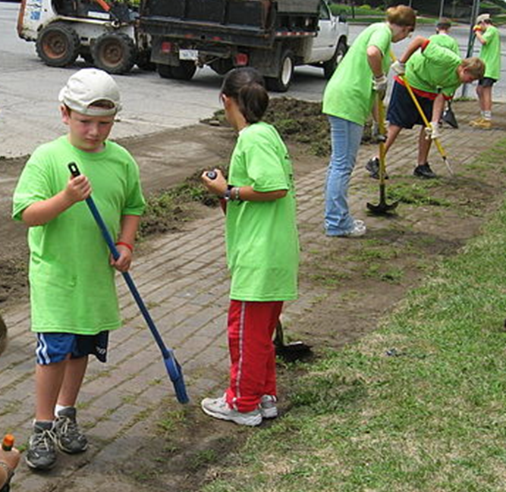
What do you know about PHILANTHROPY?
DICTIONARY DEFINITION Philanthropy - the process of giving back. The act of donating money, goods, services, time or effort to support a beneficial cause and create a lasting impact.
Philanthropy has a defined objective with no financial or material reward to the donor.
In your own words, define and reflect on the meaning of philanthropy
Notes:
Teaching Notes
Teacher might say: “We can give in many ways, even if you think you have nothing to offer. How many of you have heard the word ‘philanthropy’? What do you think it means?”
Show video clip https://www.youtube.com/watch?v=tZ5t8xD7qGU by clicking on PPT slide 6 and then on the play button.
(Tap PPT for fade-in) Philanthropy - the process of giving back. The act of donating money, goods, services, time and/or effort to support a beneficial cause, with a defined objective and with no financial or material reward to the donor.)
Prompt a whole group reflective discussion with these questions:
How is philanthropy more than money? (call on 3-4 students to respond)
How else can you give? (call on 3-4 students to respond)
What were some examples that the people in the video gave for how philanthropy made them FEEL? (call on 3-4 students to respond)
Ask students to write their own definition of “philanthropy” in their Student Workbook L1V1 (lesson 1 words included)

Slide 7
Reflecting on the 3T’s
CLICK HERE TO PLAY
Time
Talent
Treasure
Notes:
Teaching Notes
Show OtterCares-created video by clicking on the play button on PPT slide 7.
Ask 2-3 students to respond to each of these questions:
How can you donate time to something or someone?
How can you donate your talents to something or someone?
What kinds of treasure do you have to donate to something or someone?
With students still in six groups from the needs / service T-chart, , explain the instructions for their group work:
Work together to brainstorm all the different ways that your group could donate time, your unique talents, and treasures to someone or something.
Record with your group as many ways that you can donate time, talent and treasure to the assigned group from earlier (families, schools, communities.)
Try to come up with as many as you can for each column before the time is up.
Allow up to ten minutes for this activity, and then call time. Ask students to place their posters on a classroom wall or bulletin board (using either tape, thumb tacks, stapler, etc.)
[Alternate Extension Activity] Ask students to share with a partner or triad group their favorite 3 T’s that they could personally give.

Slide 8
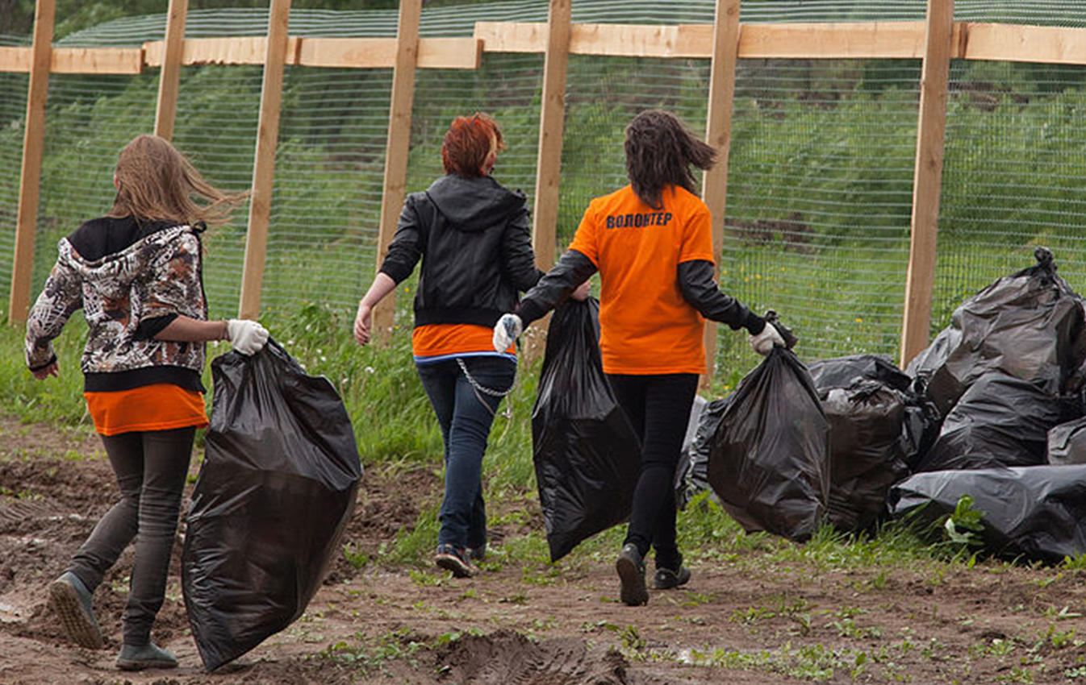
PHILANTHROPY - WHAT WILL YOU DO?
Notes:
Teaching Notes
Ask students to respond to:
“How could you use your 3 T’s to help families, schools, and communities?”
Students should record their ideas on Workbook page L1.W1.
[Extension Activity and/or Homework choices]
[Alternative Extension Activity] Students can make a goal to do one thing to start giving, and then Instagram or snapchat a picture of themselves taking a step toward that goal (for example, a student might want to donate cans of food for a hunger issue within the school, and so they might take a “selfie” of themselves collecting food from their pantry.) Students can use a hashtag like #givingisgood

