Slide 1
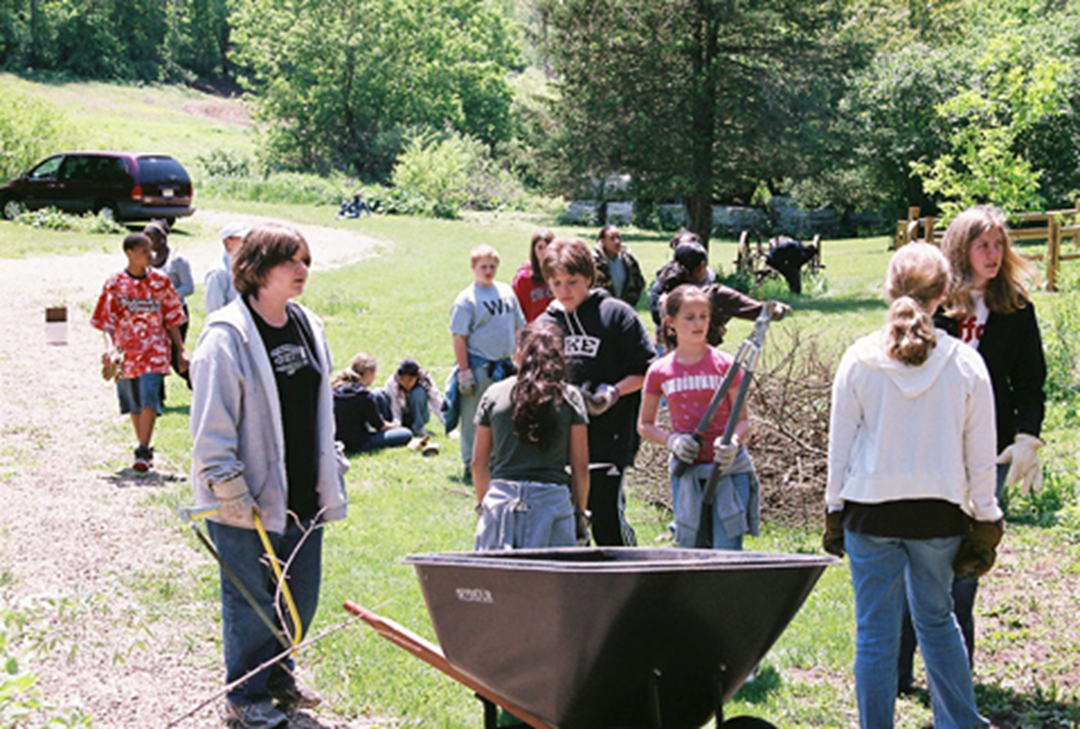
LESSON 5 - WHO CAN WE HELP?

Slide 2
What is a NONPROFIT?

Slide 3
What is a NONPROFIT?
A nonprofit is an organization whose purpose is something other than making a profit.
It’s like if you and your friends started a club where you worked together to do really helpful things for people in your community, without making money for yourselves.

Slide 4
I WANT TO HELP…
PEOPLE WITH MEDICAL NEEDS
ANIMALS
PEOPLE WITH DISABILITIES
OUR SCHOOL
THE ENVIRONMENT
KIDS
HOUSING NEEDS
FOOD INSECURITY

Slide 5
WE ARE
PHILANTHROPISTS!!

