Slide 1
LESSON 4 - WHAT IS A MISSION STATEMENT?

Slide 2
“IT DOESN’T MATTER HOW FAST YOU ARE GOING IF YOU’RE HEADING IN THE WRONG DIRECTION.”
-Steven R. Covey
What does this statement mean to you?

Slide 3
What is a
mission statement?

Slide 4
A mission statement is…
a description of the purpose of a group or organization; a reason for existing.

Slide 5
Who’s mission statement do you think this is?

Slide 6
“TO BE THE BEST SPORTS BRAND IN THE WORLD.”

Slide 7
“TO BE THE BEST SPORTS BRAND IN THE WORLD.”
-ADIDAS

Slide 8
“TO SAVE PEOPLE MONEY SO THEY CAN LIVE BETTER.”

Slide 9
“TO SAVE PEOPLE MONEY SO THEY CAN LIVE BETTER.”
-WALMART

Slide 10
“TO REFRESH THE WORLD AND MAKE A DIFFERENCE.”

Slide 11
“TO REFRESH THE WORLD AND MAKE A DIFFERENCE.”
-COCA-COLA

Slide 12
What will YOUR mission statement say about YOU?

Slide 13
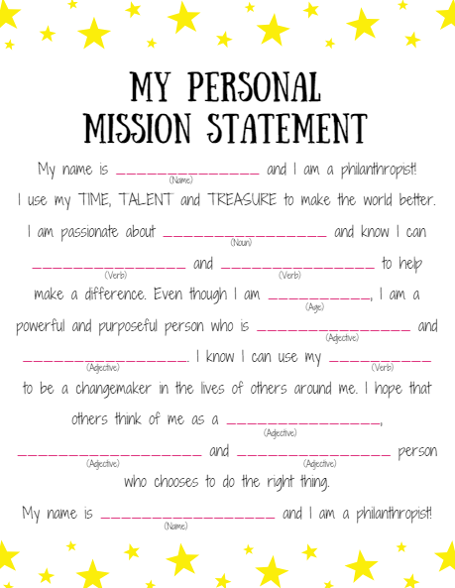
Follow the instructions on your worksheet to write your personal mission statement. Fill in the blanks using the following types of words:
Noun - person, place or thing
Verb - action word
Adjective - descriptor

Slide 14
Look back at your PERSONAL PASSIONS mind map to help you write your mission statement!
What did you say was important to you?
What did you say you could do to make a difference?

Slide 15
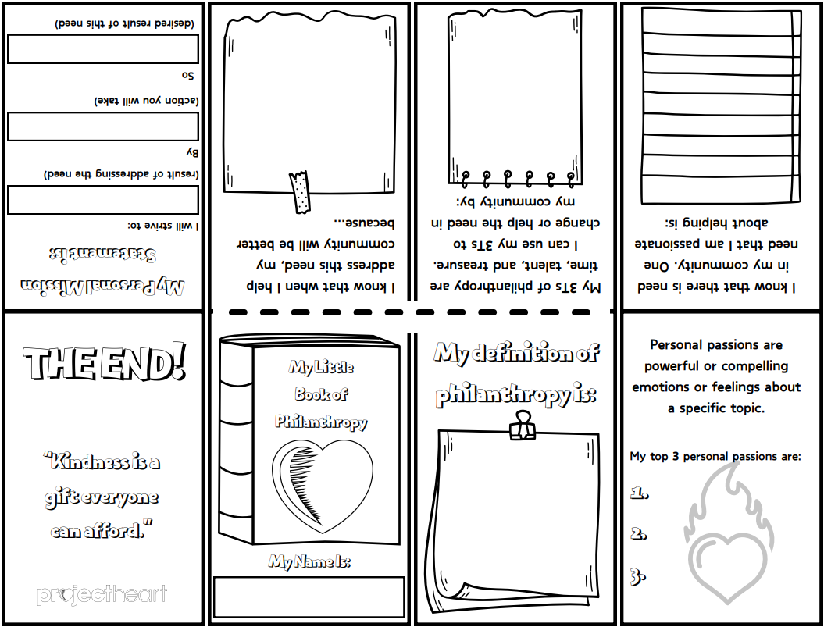
My Little Book of Philanthropy
Let’s make a pocket guide that we can carry around to help us remember a difference we can make in our communities!
https://youtu.be/TpqvTinDgVM?si=p0jWAUmw2pyvXOKe

Slide 16
My Little Book of Philanthropy
Fold and crease the paper along each line.
STEP 1

Slide 17
My Little Book of Philanthropy
Fold the paper in half and use scissors to cut just along the dotted line.
STEP 2

Slide 18
My Little Book of Philanthropy
Fold the paper in half long ways and push the two ends together so that the section you just cut opens.
STEP 3

Slide 19
My Little Book of Philanthropy
Fold the rest of the pages together so that you create a small book. Page 1 (My Little Book of Philanthropy) should be your title page.
STEP 4
7
6
5
4
8
1
2
3

Slide 20
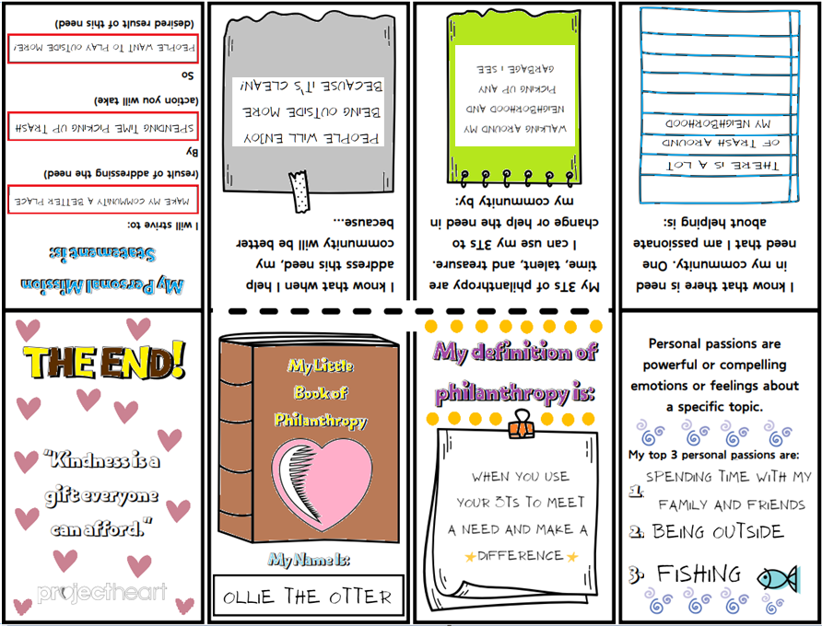
My Little Book of Philanthropy
Write on each page to make this book unique to YOU! Color using crayons or colored pencils to make it fun!
STEP 5

Slide 21
Inspiring students to become entrepreneurs and philanthropists

