Slide 1
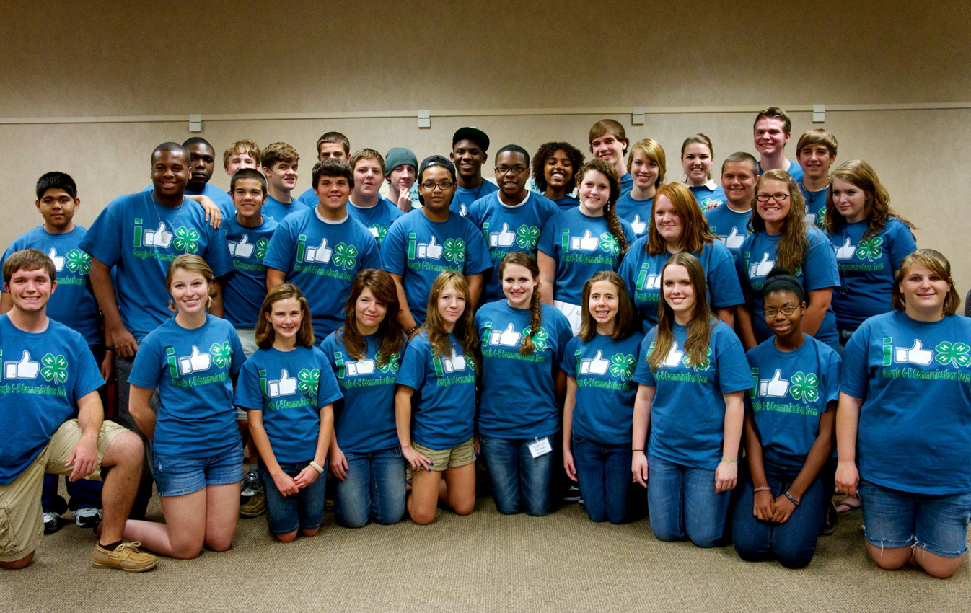
LESSON 3 - WHAT IS A NONPROFIT + WHAT AM I PASSIONATE ABOUT?

Slide 2
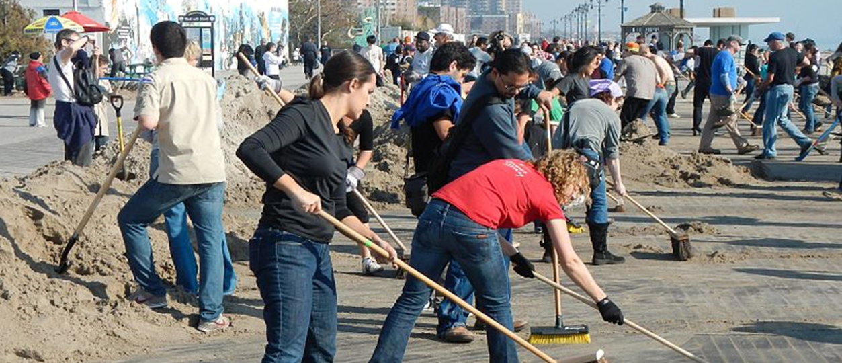
What do you know about VOLUNTEERS?
A volunteer is person who does work without getting paid.
SYNONYM: PHILANTHROPIST

Slide 3
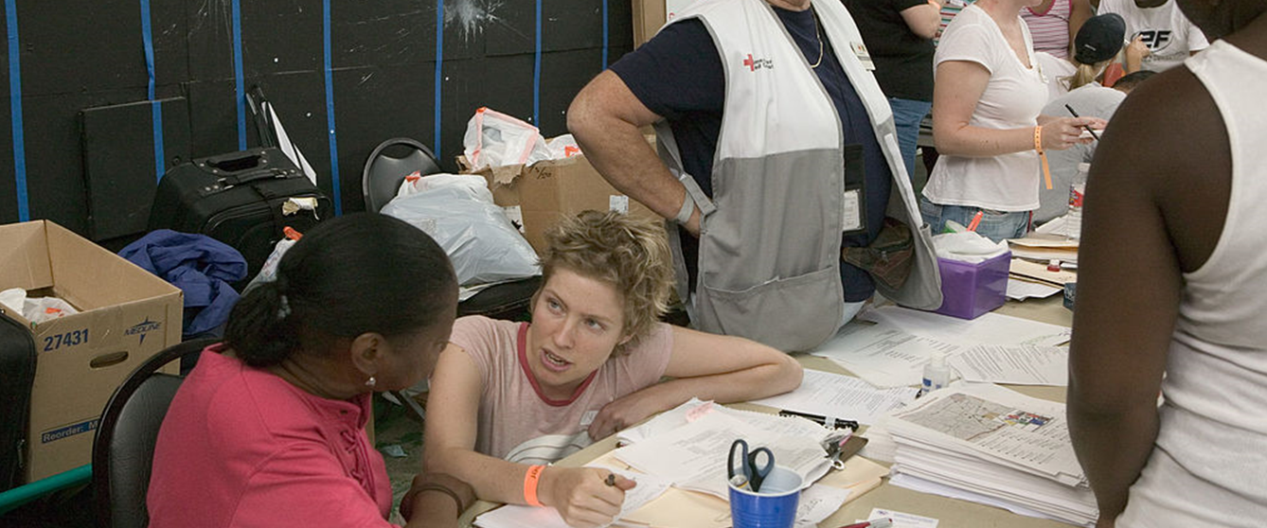
What do you know about NONPROFITS?
A nonprofit is an organization whose purpose is something other than making a profit.

Slide 4
WE WILL BE RESEARCHING NONPROFITS WHO ARE MEETING NEEDS IN COMMUNITIES
But first….

Slide 5
…let’s research together!
Look up your local animal shelter
Research Questions
1. What is the name of the nonprofit?
2. What is the mission statement? A mission statement describes why a nonprofit exists.
3. Who do they serve?
4. What community needs are they meeting?
5. How are they meeting these needs?

Slide 6
RESEARCH WHAT SOME NONPROFITS ARE DOING IN COMMUNITIES
KIDS
ANIMALS
MEDICAL
ENVIRONMENTAL
FOOD
HOUSING

Slide 7
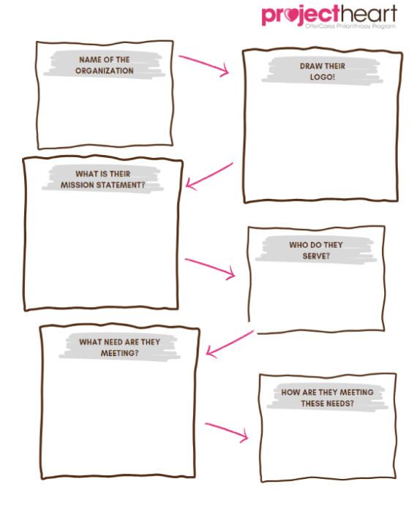
Answer the following questions about your assigned nonprofit:
1. What is the name of the nonprofit?
2. What does their logo look like?
2. What is the mission statement?
3. Who do they serve?
4. What community needs are they meeting?
5. How are they meeting these needs?

Slide 8
What do you know about PERSONAL PASSIONS?
A personal passion is a powerful or compelling emotion or feeling about a specific topic.
Explain how philanthropy affects you and your community

Slide 9
Ask yourself these questions…
What if you were a superhero and your superpower was to fight things that were unfair. What unfairness would you solve first?
What if you had an extra hour in your day? What would you spend it doing?
What is one thing you can talk to your friends about without getting bored?
What if you could create your own class or club at school? What would it be?
THESE are your personal passions!

Slide 10
Let’s learn about more student philanthropists!
DUNN IB WORLD SCHOOL
CARRIE MARTIN ELEMENTARY
Gifted and Talented students at Dunn IB World School in Fort Collins, Colorado worked to identify three things they were passionate about - providing shelter puppies with medical care, providing education and rescue services for reptiles and amphibians, and educating their classmates about the importance of inclusion for students with disabilities. Each class came up with their own unique service project to help bring awareness of these causes to students and families at their school.
Third graders at Carrie Martin Elementary School in Loveland, Colorado mixed their entrepreneurial spirit with their desire to give back. Students worked together to create businesses for their Entrepreneurship Fair, where all money collected from items sold would benefit Paragon Service Dogs, a nonprofit that provides trained service dogs to individuals in need. The class knocked their goal out of the park and raised over $1,000 AND they got to meet a service dog in training!

Slide 11
What were some of the personal passions of the students in these stories?

Slide 12
What about YOU?
What are you passionate about helping?

Slide 13
Let’s MIND MAP!!
WHAT IS A MIND MAP? A mind map can be used to help you visually organize information
Write your name in the center circle
Write down four of your personal passions and put them in the circles that branch off from the large center circle. What do you care a lot about?
Think up ways that you could fill a need or give back to your community for each passion using your 3Ts
Don’t forget to illustrate! Make this yours! Get creative!

Slide 14
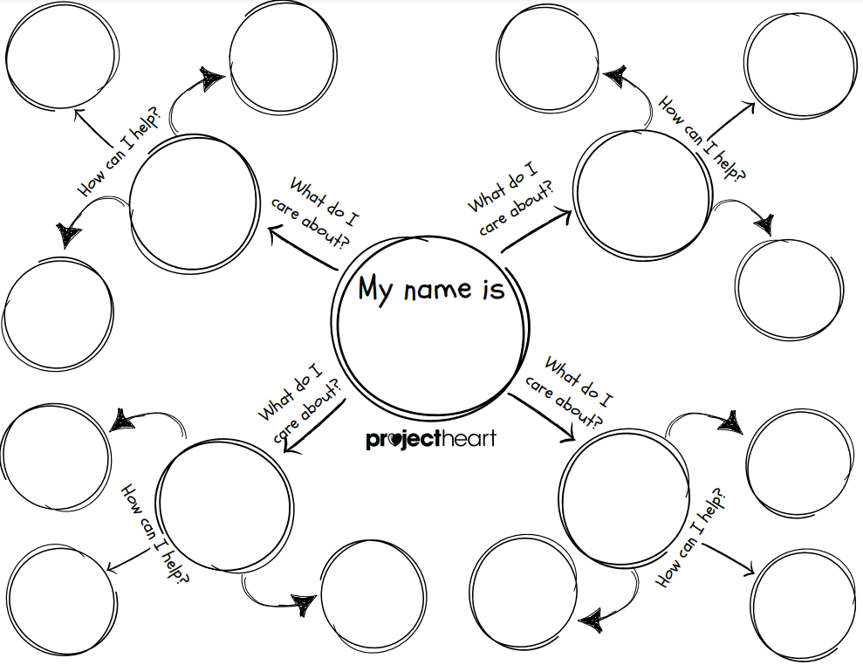

Slide 15
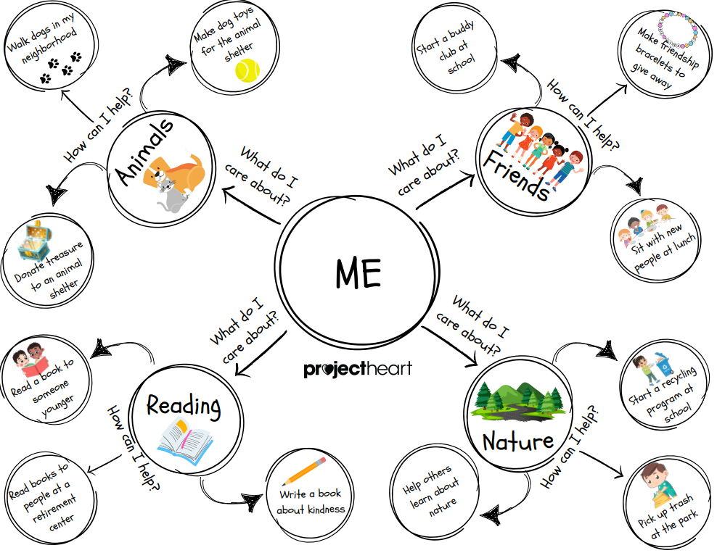

Slide 16
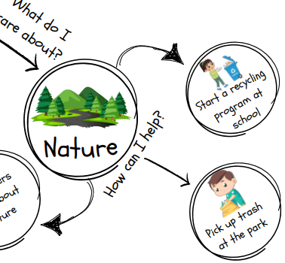
You can always write in more thoughts! What are some next steps you can take to help you fill that need?
How many people do I need to help me?
Make flyers and hang them up around the school
Who do I need to ask permission from to do this?
What park near me needs the most help?
Materials I need:
Bags
Gloves

Slide 17
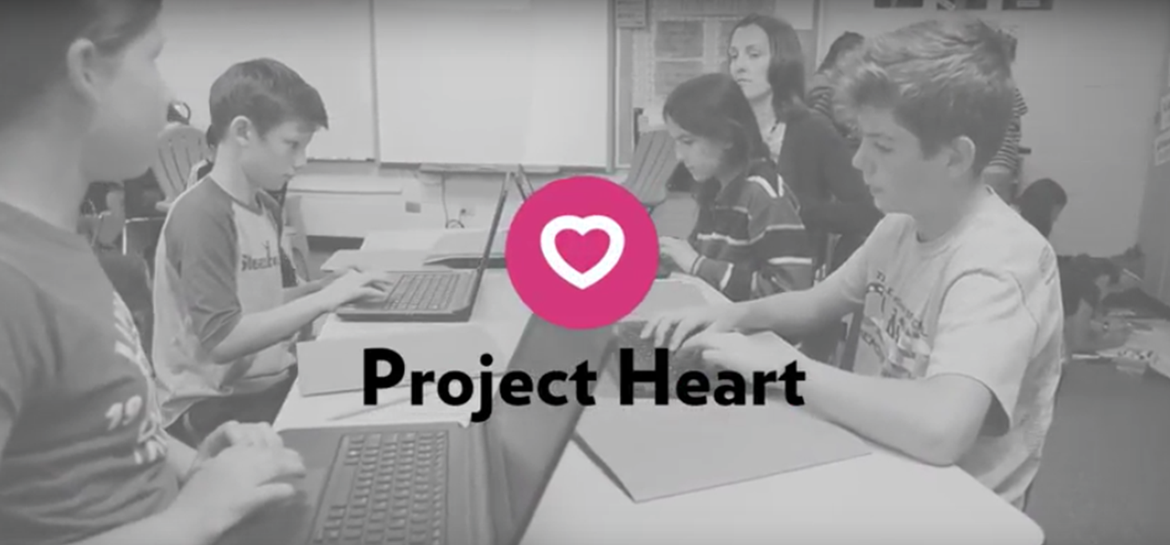
PHILANTHROPY - WHAT WILL YOU DO?

