Slide 1
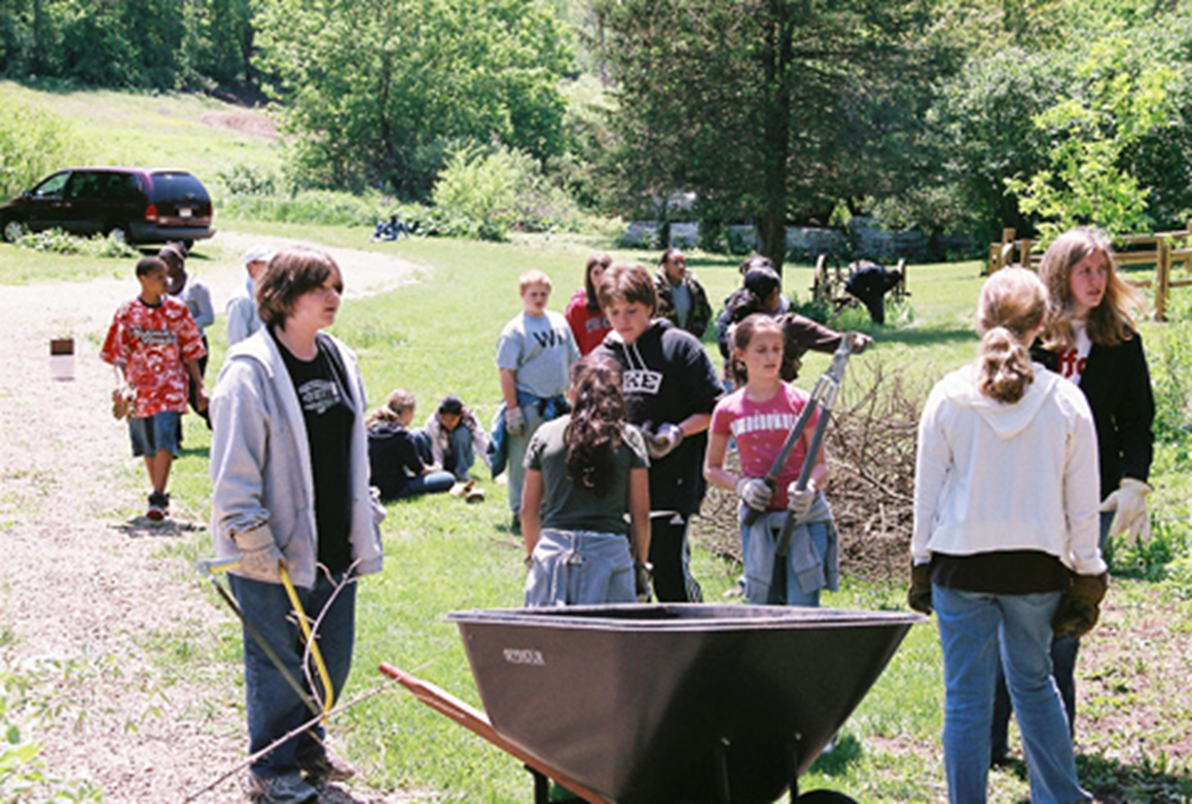
LESSON 2 - WHO ARE PHILANTHROPISTS?

Slide 2
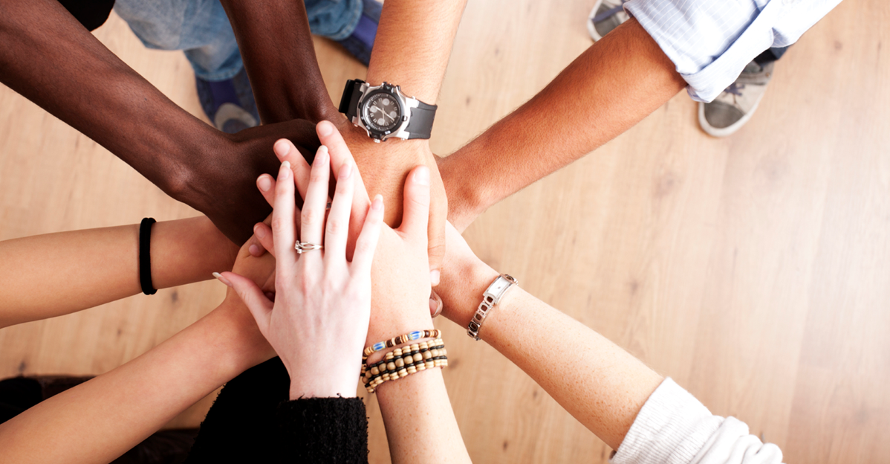
What is a philanthropist?
Identify the role of a philanthropist in a community

Slide 3
A philanthropist is…
someone who uses their time, talent, and/or treasure to someone or something in need.
Identify the role of a philanthropist in a community

Slide 4
BEFORE THE VIDEOS
Listen for key terms and big ideas
Learn as much as you can from these philanthropists
Seek evidence of the 3 T’s - time, talent, treasure
Identify the role of a philanthropist in a community

Slide 5
NANCY RICHARDSON
LOPEZ ELEMENTARY
BAMFORD ELEMENTARY
Nancy Richardson founded The OtterCares Foundation to invest in education and empower youth to create lasting change through philanthropy and entrepreneurship. Nancy started her journey as a philanthropist in her 3rd grade classroom.
Read more about Nancy’s story HERE!
Every year, 4th grade students at Lopez Elementary School in Fort Collins, Colorado work together to make a difference. With the help of their dedicated teachers, they put on a luncheon to help raise money for Respite Care - an organization that provides care to children with developmental disabilities. Read more about this story HERE!
Students at Bamford Elementary School in Fort Collins, Colorado wanted to create a culture of giving at their school. K-5th graders all worked together to create the Pack Pantry, a place where families from their school district can come shop for clothes, diapers, food or other items…all for FREE. Read more about their story HERE!

Slide 6
JEN & L.J. HOUSKA
SHEPARDSON ELEMENTARY
KENNA CHRISTIAN
Jen and L.J. Houska own Houska Automotive. They are passionate about helping youth in Colorado, and like to give their time, talent and treasure to helping kids with cancer, kids with special needs and even have their own running race to raise money for bone marrow research!
Students at Shepardson Elementary in Fort Collins, Colorado set a goal to collect 1,000 food items to donate to their local food pantry. After a lot of hard work and dedication to their mission, they were so excited to learn that they more than tripled their goal, collecting over 3,000 items!!
At 10 years old, Kenna Christian loved to send the money she got from allowance to organizations that help save animals. Kenna has gone on to start her own business, Kenna’s Cards for a Cure. For each card that Kenna sells, part of her proceeds go towards helping provide care for women who have been diagnosed with breast cancer.

Slide 7
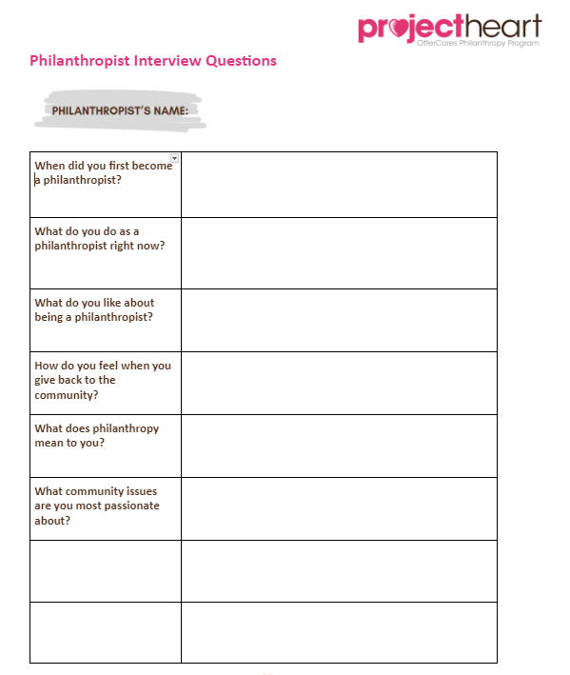
BEFORE THE VISIT
Students will be assigned questions
Take notes
Listen for key terms and big ideas
Learn as much as you can from our guest
Seek evidence of the 3Ts

Slide 8
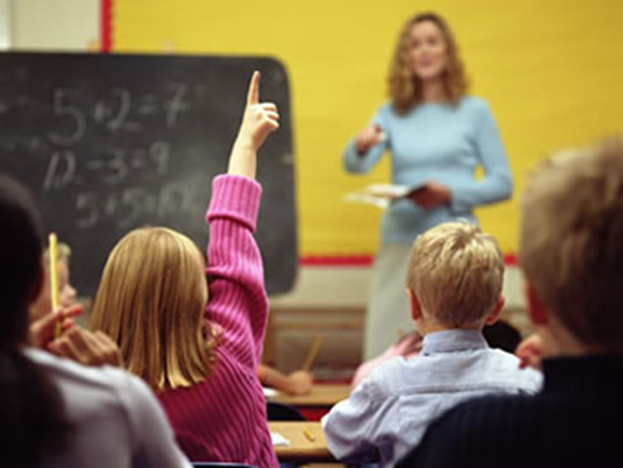
_____________ is a local philanthropist
What questions do you have for our guest?

Slide 9
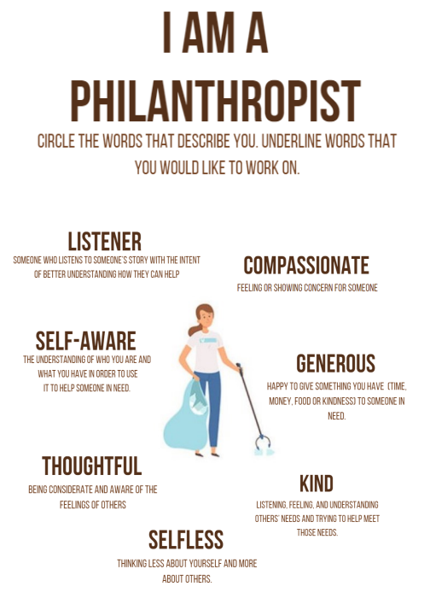
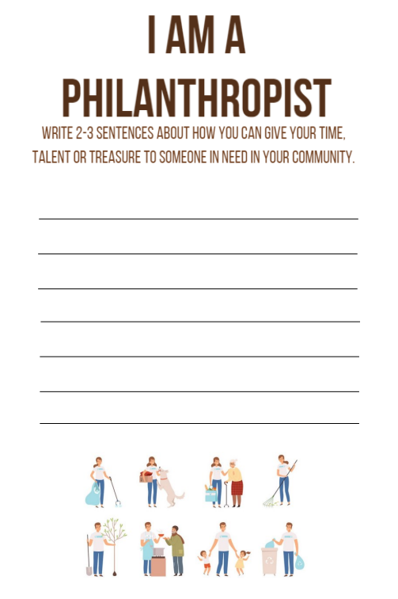
I AM A PHILANTHROPIST
Circle words that describe you. Underline what you would like to work on.
Write 2-3 sentences about how you can give your 3Ts to someone in need in your community.
FRONT
BACK

Slide 10
Reflecting on the 3Ts
Time
Talent
Treasure

