Slide 1
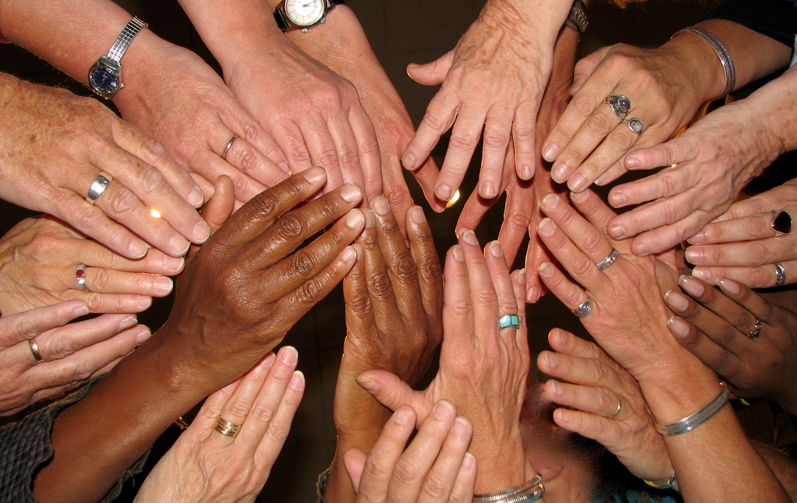
LESSON 1 - WHAT IS PHILANTHROPY?

Slide 2
Warm-Up Activity:
Take one blank sheet of paper
Find a partner sitting near you
Take a few minutes to write a kind message to your partner
What are they really good at?
Did they help you with something lately?
Did they do something nice for someone else in your class?
Did they do really well on a test?
Do you like what they’re wearing today?
Once you are finished, give your note to your partner!

Slide 3
What do you know about GIVING?
How does it feel to give?
How does it feel to receive?
Give - To offer something to someone without expecting anything in return.
In your own words, define and reflect on the meaning of philanthropy

Slide 4
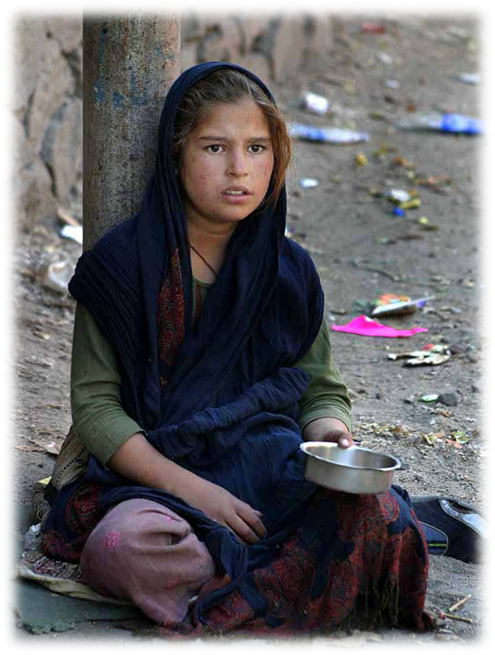
What do you know about NEEDS?
What needs do we have?
Need - to require, to be necessary
In your own words, define and reflect on the meaning of philanthropy

Slide 5
NEED OR WANT
SHELTER

Slide 6
NEED OR WANT
TOYS

Slide 7
NEED OR WANT
CLEAN WATER

Slide 8
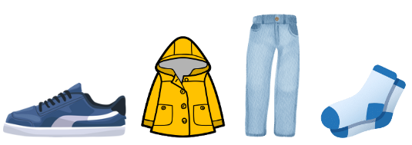
NEED OR WANT
CLOTHING + SHOES

Slide 9
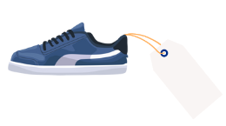
NEED OR WANT
$300
CLOTHING + SHOES

Slide 10
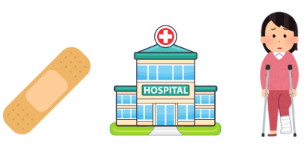
NEED OR WANT
MEDICAL CARE

Slide 11
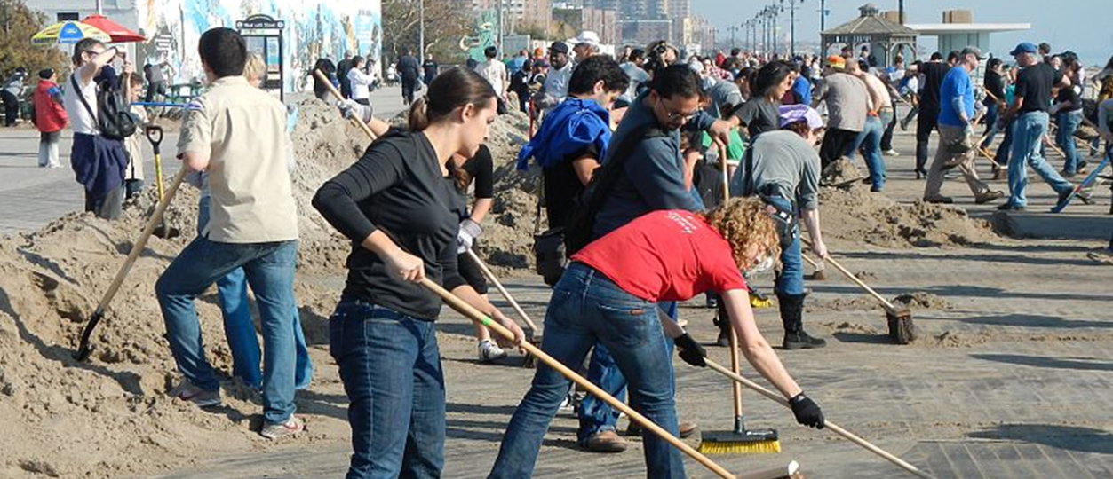
What do you know about SERVICE?
Service - the act of helpful activity
In your own words, define and reflect on the meaning of philanthropy

Slide 12
What do you know about NEEDS of Families, Schools and Communities?

Slide 13
What do you know about NEEDS of Families, Schools and Communities?
Needs
Service/What would help?
Families
A family in your neighborhood doesn’t have the money they need to buy food
Schools
A teacher at your school needs extra help in the classroom sometimes - cleaning, grading papers
Communities
You’ve noticed some people experiencing homelessness in your community

Slide 14
What is PHILANTHROPY?
Let’s hear what some people have to say about what they think philanthropy is.
CLICK TO PLAY!
In your own words, define and reflect on the meaning of philanthropy

Slide 15
What is PHILANTHROPY?
Philanthropy - the process of giving back. The act of donating money, goods, services, time or effort to support a beneficial cause and create a lasting impact.
In your own words, define and reflect on the meaning of philanthropy

Slide 16
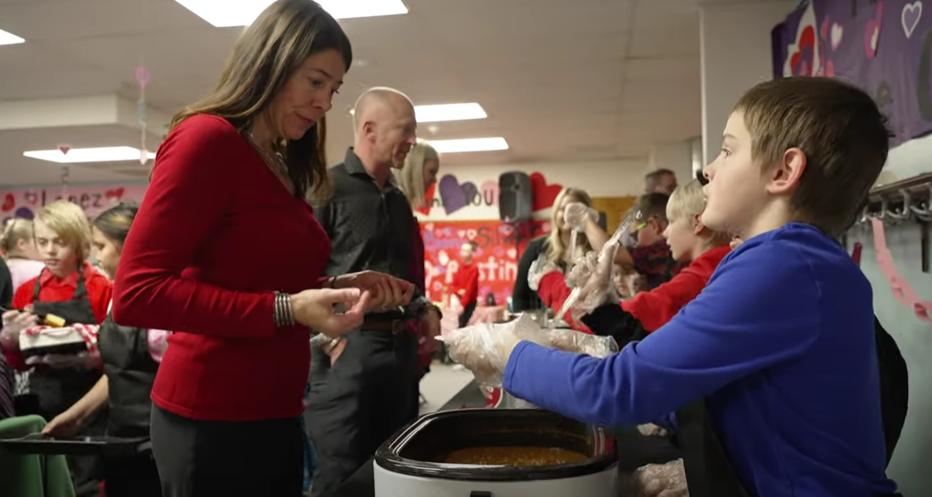
Let’s learn about some student philanthropists JUST LIKE YOU!
CLICK TO PLAY!
In your own words, define and reflect on the meaning of philanthropy

Slide 17
The 3Ts of PHILANTHROPY
Time
Talent
Treasure
When we give our time to help someone in need Picking up trash around your community or school
When we use our skills or things that we are good at to help someone Helping someone younger than you learn how to read
Giving money or goods we have to someone who needs them Donating clothes that no longer fit you to a community shelter

Slide 18
Reflecting on the 3Ts
Time
Talent
Treasure

