Slide 1
LESSON 6 - WHAT IS THE END GOAL FOR POSITIVE IMPACT?
WHERE WILL I MAKE A DIFFERENCE?

Slide 2
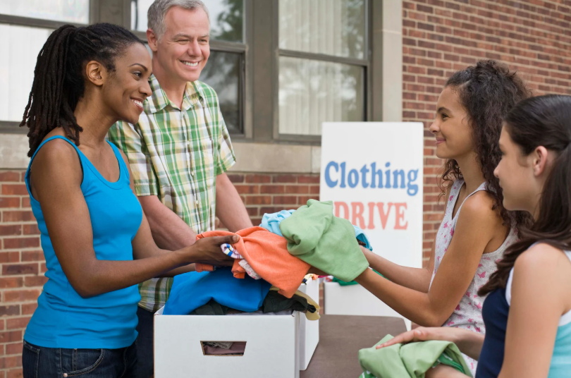
A group of middle school students live in a community recently impacted by a natural disaster, which left many without homes, food, clothing, and clean water. Despite experiencing personal loss themselves—including their own homes and belongings—they were determined to help others. They organized a collection drive at their school and reached out to neighboring towns, asking for donations to support those in need within their community.
How can people use their shared struggles to lift each other up and make a difference?
WARM-UP

Slide 3







RESEARCH WHAT SOME NONPROFITS ARE DOING IN COMMUNITIES
KIDS
ANIMALS
MEDICAL
ENVIRONMENTAL
FOOD
HOUSING

Slide 4
WHAT IS YOUR END GOAL?
How will our project(s) make an
IMPACT
…on others and on YOU?

