Slide 1
LESSON 4 - IMPACTING OTHERS LOCALLY, NATIONALLY AND GLOBALLY
HOW FAR DO YOU WANT TO REACH?

Slide 2
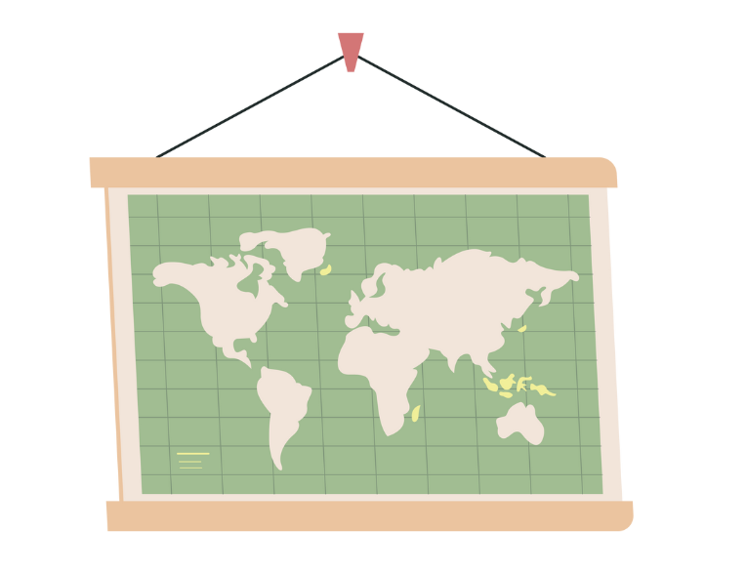
Differences between HERE and THERE
WHO could you donate your 3Ts to? HOW could you do it?

Slide 3
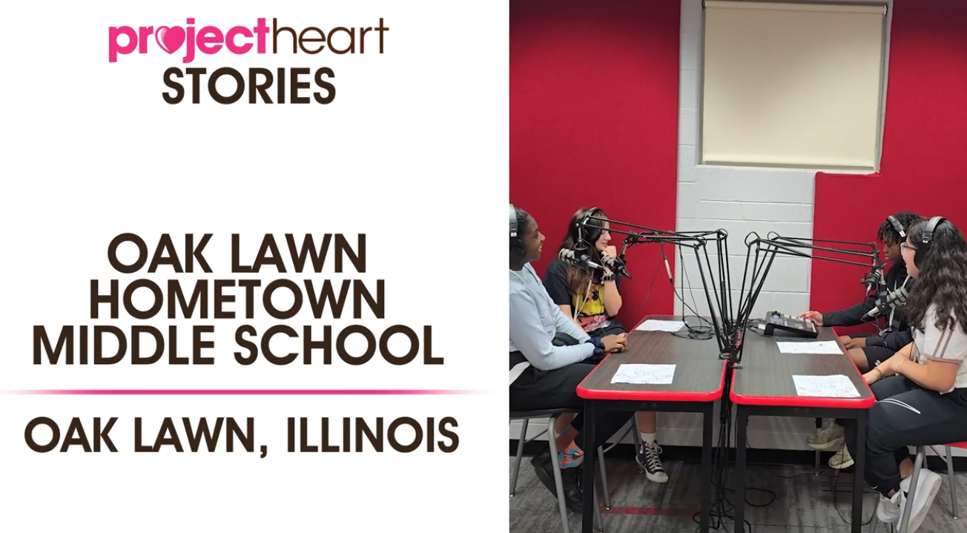

PROJECT HEART SPOTLIGHT:
Check out how middle school students in Illinois are working to help make global change!
CLICK HERE TO PLAY

Slide 4

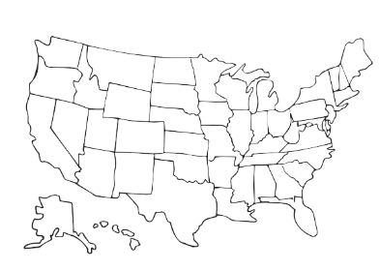

GROUP ACTIVITY: WHAT NEEDS EXIST…
LOCALLY
NATIONALLY
GLOBALLY

Slide 5
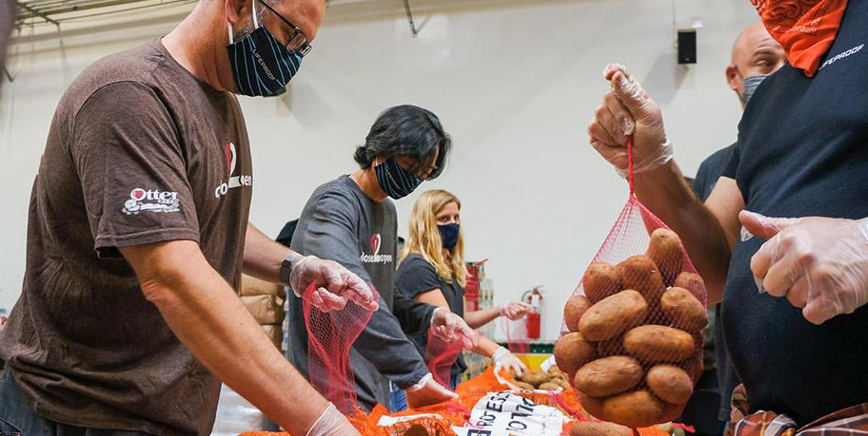
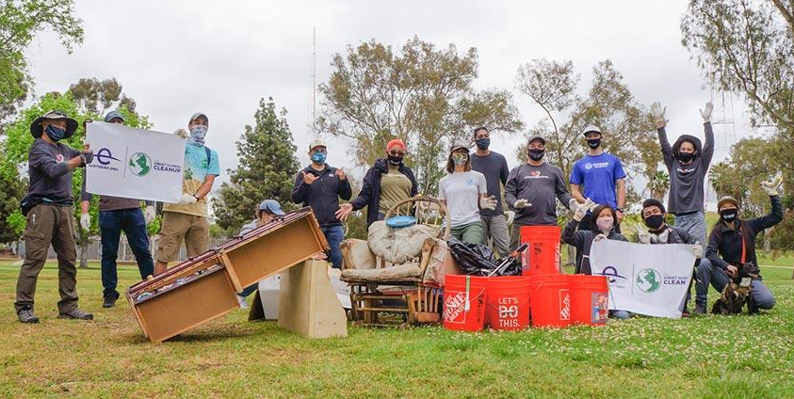
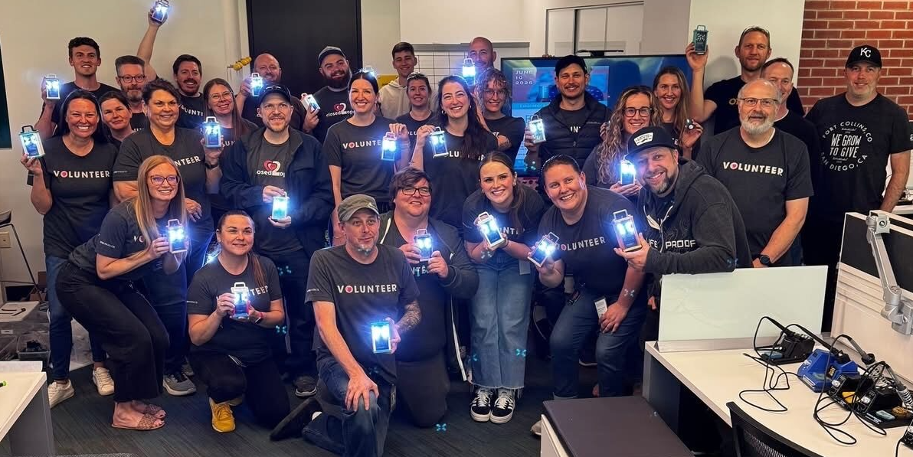
WHAT WILL YOU DO?

