Slide 1
LESSON 2 - EVALUATING PHILANTHROPY
CLICK TO PLAY!

Slide 2
WHAT IS EFFECTIVE PHILANTHROPY?

Slide 3
The American Cancer Society works to improve the lives of people with cancer and their families through advocacy, research, and patient support to ensure everyone has an opportunity to prevent, detect, treat, and survive cancer.
American Red Cross volunteers and staff work to deliver vital services - from providing relief and support to those in crisis, to helping you be prepared to respond in emergencies. They feed and provide comfort to people affected by disasters, supply about 40% of the nation’s blood, teach skills that save lives and support veterans.
The American Society for the Prevention of Cruelty to Animals works to save animals from dogfighting, puppy mills, hoarding and other cruelty situations. They provide animals with medical care, behavioral rehabilitation, and help thousands of animals find loving homes every year.

Slide 4
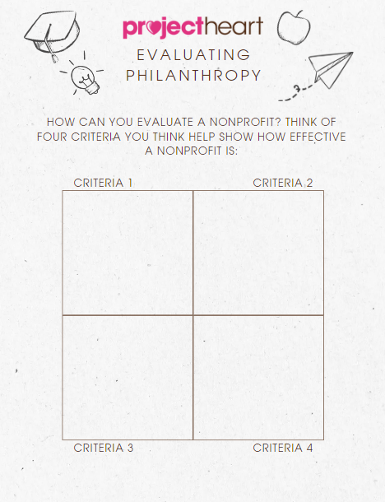
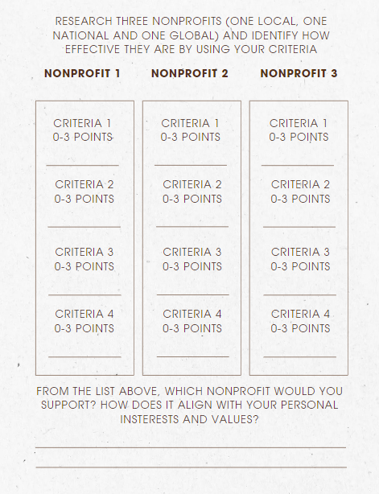
NOW CHOOSE YOUR OWN CRITERIA AND THREE NONPROFITS - ONE LOCAL, NATIONAL, AND GLOBAL
Write the name of the nonprofit here

Slide 5
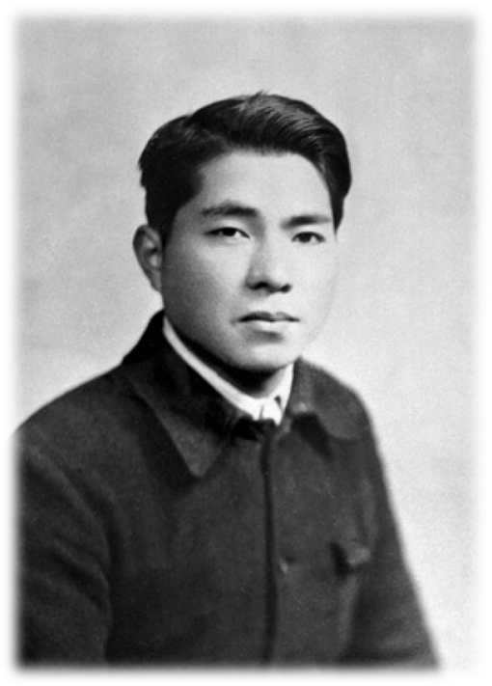
WHO WILL YOU HELP?
“No matter how wonderful our dreams, how noble our ideals or how high our hopes, ultimately we need courage to make them a reality. Without action, it’s as if our dreams and ideals never existed.”
Daisaku Ikeda
(philosopher, educator, and author)

