Slide 1
LESSON 8 - CREATE VIRAL AWARENESS
HAVE FUN AND LEAVE A MARK!

Slide 2
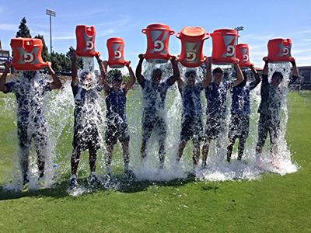
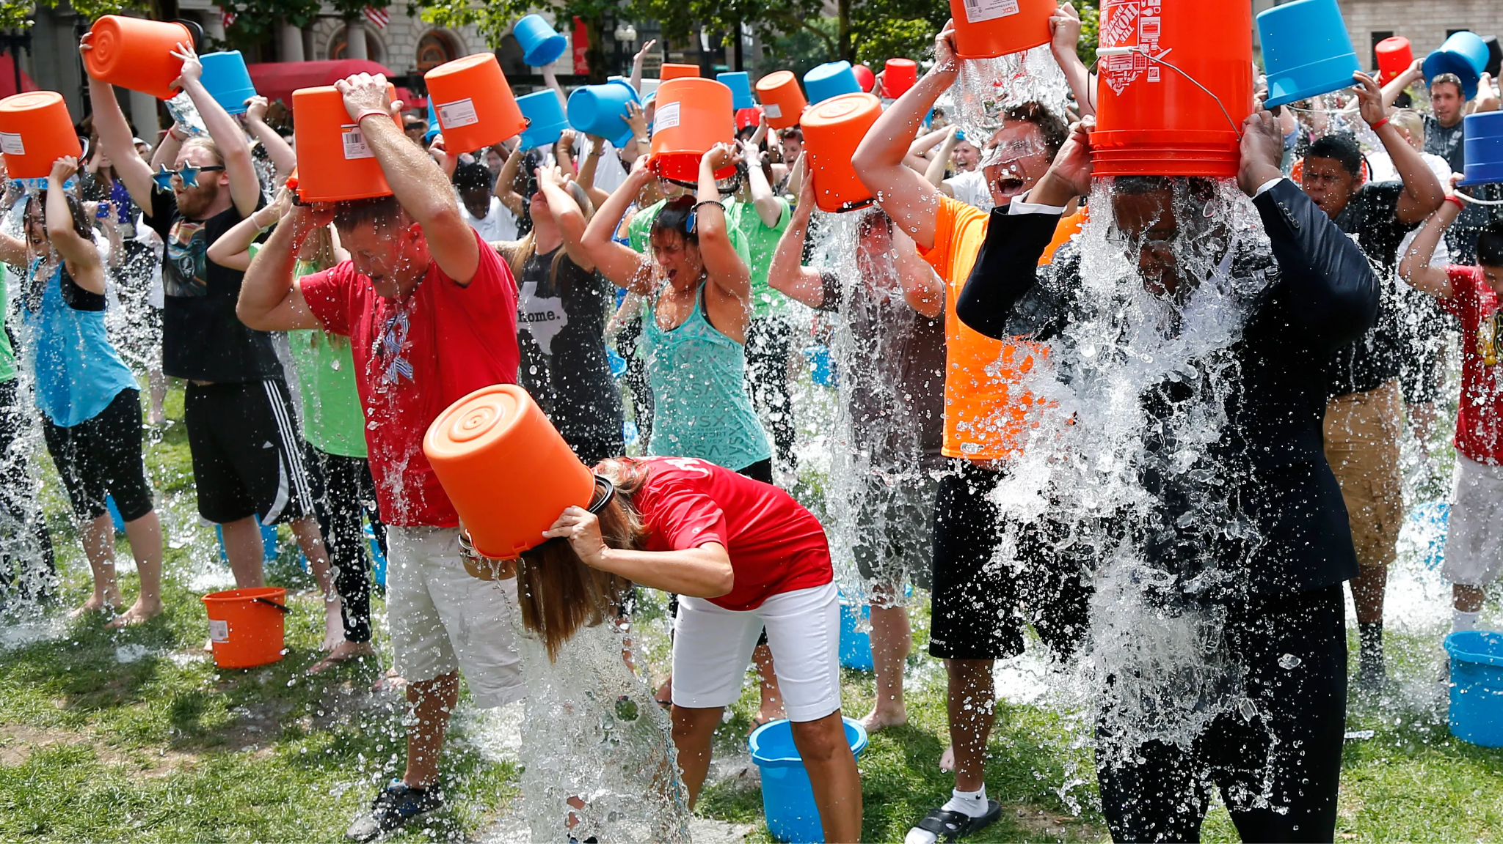
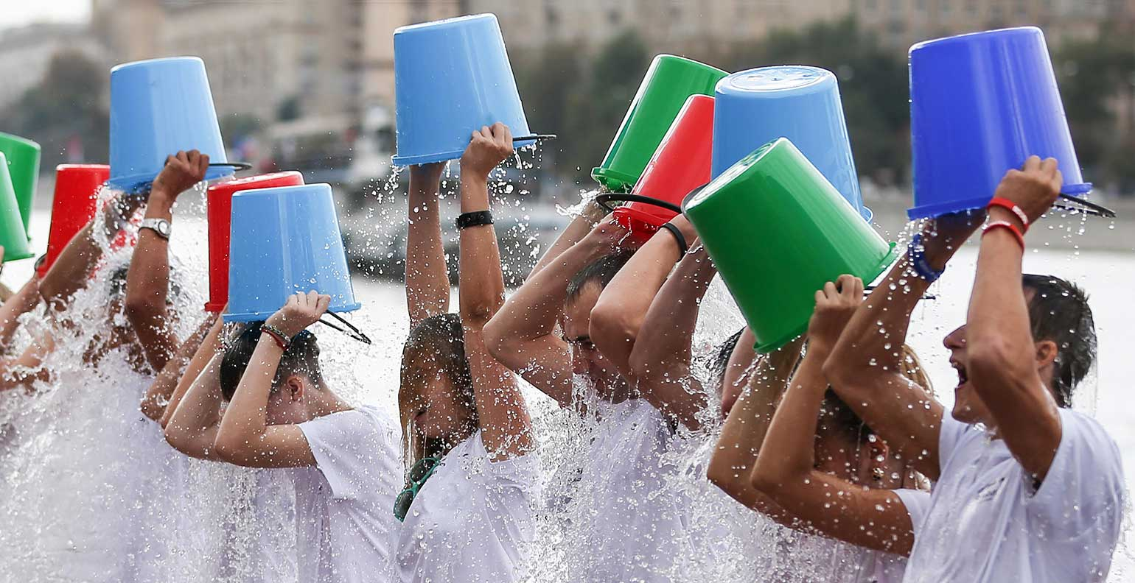
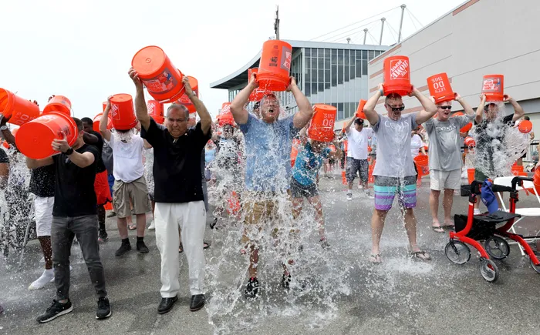
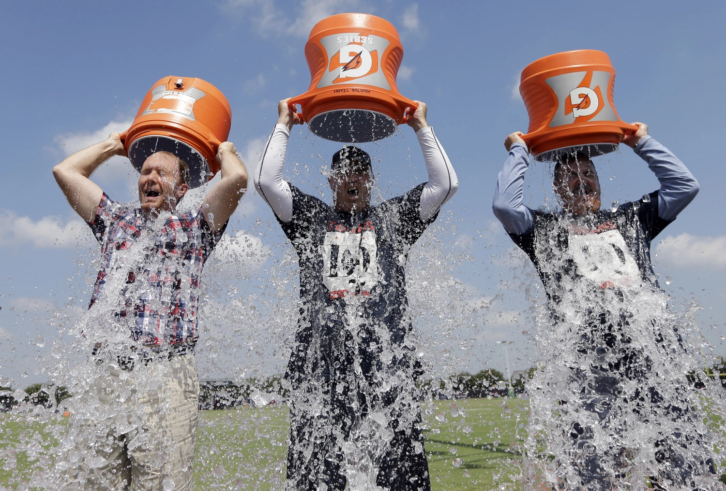
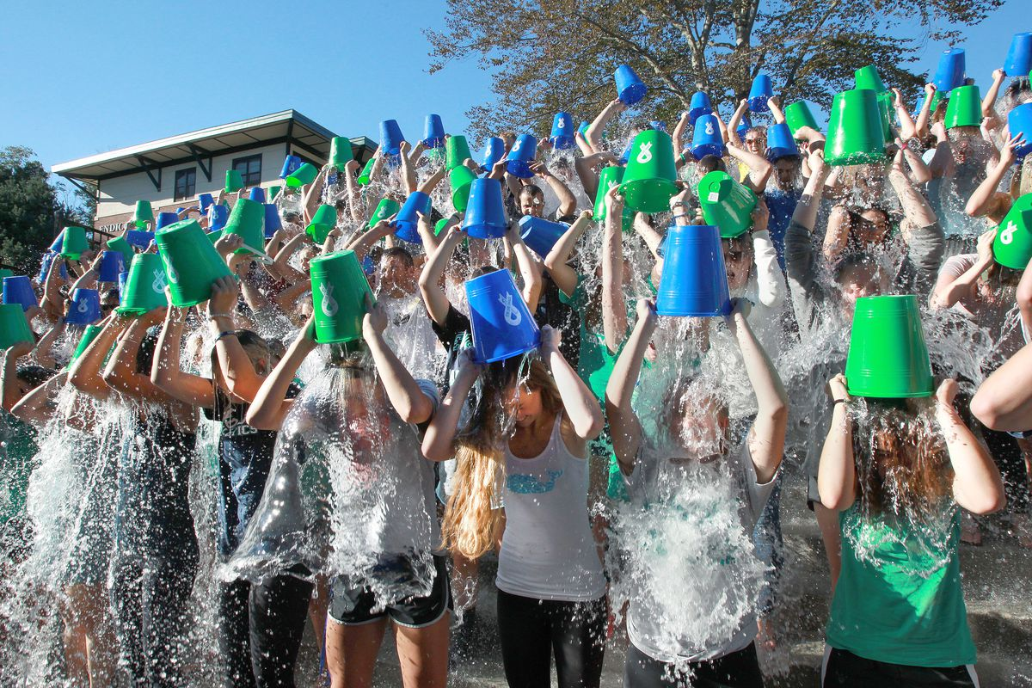
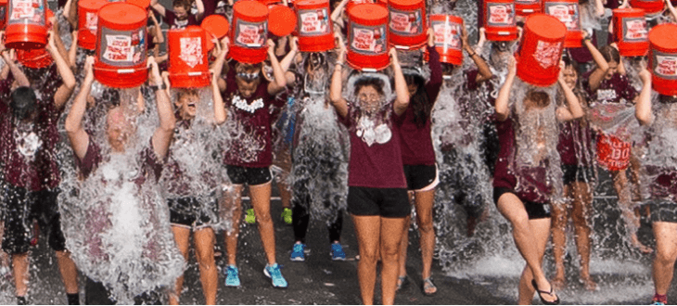

Slide 3
HOW CAN YOU RAISE AWARENESS WITH MARKETING TOOLS?
Define your mission/goal of your project in your marketing
Do something visible to market your idea (ex. challenges on social media
Reach out to individuals or organizations that could support you
Contact local news teams (TV and radio stations) to do a press release or story on your efforts with details on how people could support you (think 3Ts)
Talk to people in your community and communicate why you’re so passionate about this project (post to social media and distribute flyers to generate buzz)

Slide 4
HOW WILL YOU TELL THEM?
I (we) will use___________________________ to
(marketing tools)
target ____________________________ so that (people, organizations, locations)
I (we) can share the story about _______________.
(intended impact)

