Slide 1
LESSON 4 - PHILANTHROPY WITH PURPOSE
WHAT DO YOU WANT TO DO? WHY DO YOU WANT TO DO IT?
CLICK TO PLAY!

Slide 2
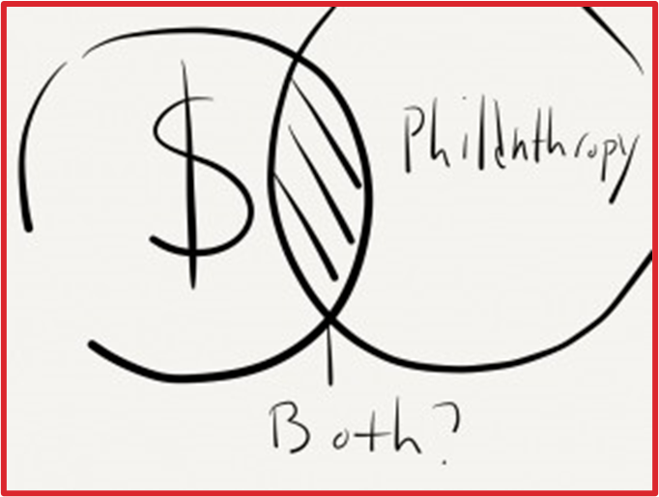
HOW WOULD YOU INVEST FOR SOCIAL IMPACT?
“Giving is deeply emotional. But supplementing emotion with research makes it more likely that a gift can have a bigger impact. It’s like any investment. You wouldn't put funds into stocks or bonds without understanding the potential return. Why wouldn’t you do the same when investing in society?”
-Laura Arrillaga Andreessen

Slide 3
TYPES OF IMPACT INVESTING
Invest in companies with an explicit social mission. For example - companies that focus on solar power or alternative fuels.
Investing in companies that align with your values.
Donating and supporting nonprofits that blend charitable support with investment capital to support higher-risk projects that may not be otherwise financially viable.
Lend money to a nonprofit, whose mission you want to support.

Slide 4
MISSION STATEMENT VS VISION STATEMENT
A short statement of why an organization exists - what its overall goal is, what kind of product or service it provides, etc.
What an organization (or you!!) would look like 10 years from now if it achieved all of its goals.

Slide 5
MISSION STATEMENT VS VISION STATEMENT
To provide comprehensive companion animal resources, services, and education to the community to prevent homelessness and promote the human-animal bond.
All companion animals experience a healthy home where they are wanted, cared for, and loved.
ANIMAL FRIENDS ALLIANCE

Slide 6
WHO SAID THAT…
“With every cup, with every conversation, with every community - we nurture the limitless possibilities of human connection.”

Slide 7
WHO SAID THAT…
“With every cup, with every conversation, with every community - we nurture the limitless possibilities of human connection.”
STARBUCKS

Slide 8
WHO SAID THAT…
“To be the best sports brand in the world.”

Slide 9
WHO SAID THAT…
“To be the best sports brand in the world.”
ADIDAS

Slide 10
WHO SAID THAT…
“To save people money so they can live better.”

Slide 11
WHO SAID THAT…
“To save people money so they can live better.”
WALMART

Slide 12
YOU SAID THAT…
Decide what you want your mission statement to say about you…
Should be based on what you want to achieve and why
Should be short - 1-2 sentences
Should be based on what you’re good at or feel strongly about - think about your personal passions!
Should involve reflecting on how you want to be remembered
Should be a starting point to creating goals towards your dreams

Slide 13
YOU SAID THAT…
My mission is to (result of addressing a need) by (action you can take) so (result of the change).

Slide 14
YOU SAID THAT…
For example…
“My mission is to better the lives of shelter pets by volunteering one hour per week at my local animal shelter so that I can bring joy and happiness to animals that have been surrendered or neglected.”

Slide 15
YOU SAID THAT…
For example…
“My mission is to make a difference in the lives of others by sharing my life experiences and knowledge about diabetes so that we can bring more awareness to this condition.”

Slide 16
YOU SAID THAT…
My mission is to (result of addressing a need) by (action you can take) so (result of the change).

